Slide 1
Chapter 4
The Processor
Abdullah Yasin Nur

Slide 2
Review: MIPS (RISC) Design Principles
Simplicity favors regularity
fixed size instructions
small number of instruction formats
opcode always the first 6 bits
Smaller is faster
limited instruction set
limited number of registers in register file
limited number of addressing modes
Make the common case fast
arithmetic operands from the register file (load-store machine)
allow instructions to contain immediate operands
Good design demands good compromises
three instruction formats
Notes:
x86, variable instruction set: 1 to 17 bytes in length

Slide 3
The Processor Design
§4.1 Introduction
We will examine two MIPS implementations
A simplified version
A more realistic pipelined version
Simple subset, shows most aspects
Memory reference: lw, sw
Arithmetic/logical: add, sub, and, or, slt
Control transfer: beq, j

Slide 4
MIPS R-format Instructions
Review
op
rs
rt
rd
shamt
funct
6 bits
5 bits
5 bits
5 bits
5 bits
6 bits
Instruction fields
op: Basic operation of the instruction, called opcode or operation code.
rs: first source register number
rt: second source register number
rd: destination register number
shamt: shift amount (00000 for now)
funct: function code (extends opcode)

Slide 5
R-format Example
Review
op
rs
rt
rd
shamt
funct
6 bits
5 bits
5 bits
5 bits
5 bits
6 bits
add $t0, $s1, $s2
special
$s1
$s2
$t0
0
add
0
17
18
8
0
32
000000
10001
10010
01000
00000
100000
00000010001100100100000000100000₂ = 02324020₁₆
See Appendix A for other instructions …

Slide 6
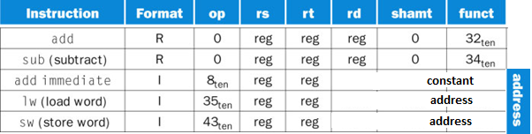
MIPS I-format Instructions
Review
op
rs
rt
constant or address
6 bits
5 bits
5 bits
16 bits
Note: in a load instruction, the rt field specifies the destination register, which receives the result of the load.
Based on op, hardware can uniquely identify instructions among various formats.
FIGURE: MIPS instruction encoding. In the table above, “reg” means a register number between 0 and 31, “address” means a 16-bit address. Note that add and sub instructions have the same value in the op field; the hardware uses the funct field to decide the variant of the operation: add (32) or subtract (34).

Slide 7
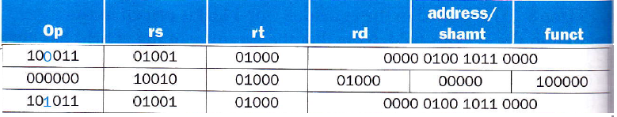
Translating MIPS to Machine Language
Review
Example: A [300] = h + A [300];
If $t1 has the base of A and $s2 maps to h
then MIPS code can be
lw $t0, 1200($t1)
add $t0, $s2, $t0
sw $t0, 1200($t1)
The corresponding machine code (in decimal) can be as following:
The corresponding machine code (in binary) can be as following:

Slide 8
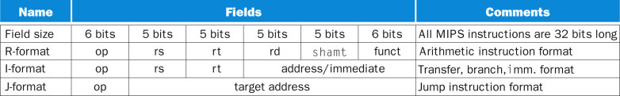
Review
3 MIPS Instructions format: R, I, J
FIGURE: MIPS instruction formats: R, I, J.
8
Copyright © 2014 Elsevier Inc. All rights reserved.

Slide 9
Instruction Execution
For every instructions, the first 2 steps are same:
1. Send the PC to the memory and fetch the instruction from that memory:
PC → instruction memory, fetch instruction
2. All instructions read one or two registers (except j):
Register numbers → register file, read registers
After the above 2 steps, depending on instruction class:
Use ALU to calculate
Arithmetic result
Memory address for load/store
Branch target address
Access data memory for load/store
PC ← target address or PC + 4

Slide 10
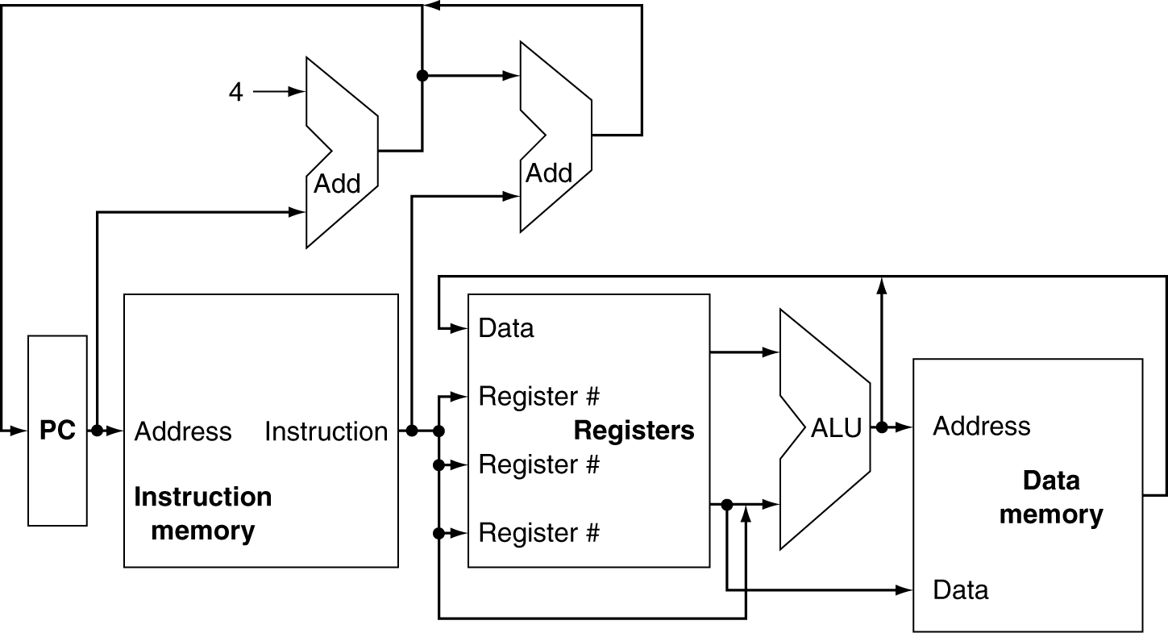
CPU Overview
Figure: An abstract view of the implementation of the MIPS subset showing the major functional units and the major connections between them.
All instructions start by using the program counter to supply the instruction address to the instruction memory. After the instruction is fetched, the register operands used by an instruction are specified by fields of that instruction. Once the register operands have been fetched, they can be operated on to compute a memory address (for a load or store), to compute an arithmetic result (for an integer arithmetic-logical instruction), or a compare (for a branch). If the instruction is an arithmetic-logical instruction, the result from the ALU must be written to a register. If the operation is a load or store, the ALU result is used as an address to either store a value from the registers or load a value from memory into the registers. The result from the ALU or memory is written back into the register file. Branches require the use of the ALU output to determine the next instruction address, which comes either from the ALU (where the PC and branch offset are summed) or from an adder that increments the current PC by 4. The thick lines interconnecting the functional units represent buses, which consist of multiple signals. The arrows are used to guide the reader in knowing how information flows. Since signal lines may cross, we explicitly show when crossing lines are connected by the presence of a dot where the lines cross.

Slide 11
Multiplexers
Can’t just join wires together
Use multiplexers

Slide 12
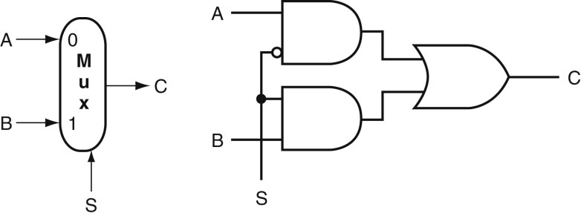
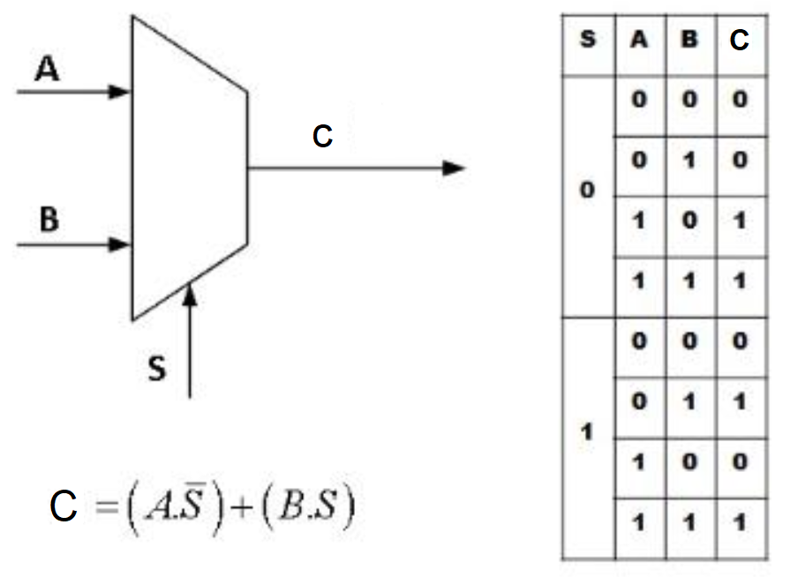
Mux (Multiplexer)
FIGURE: A two-input multiplexor on the top and its implementation with gates on the bottom. The multiplexor has two data inputs (A and B), which are labeled 0 and 1, and one selector input (S), as well as an output C.

Slide 13
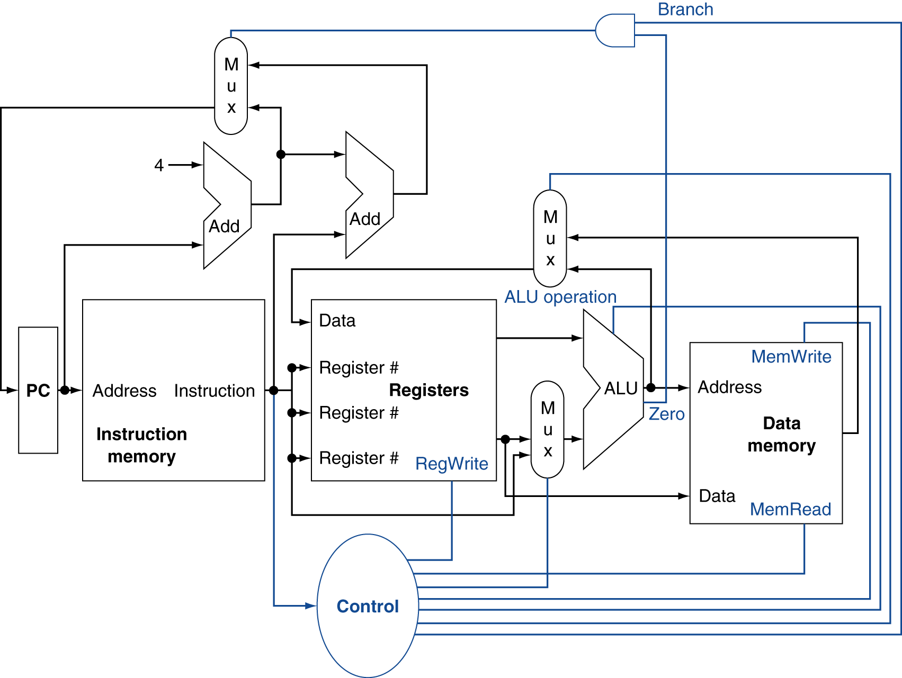
Control
FIGURE: The basic implementation of the MIPS subset, including the necessary multiplexors and control lines.
The top multiplexor (“Mux”) controls what value replaces the PC (PC + 4 or the branch destination address); the multiplexor is controlled by the gate that “ANDs” together the Zero output of the ALU and a control signal that indicates that the instruction is a branch.
The middle multiplexor, whose output returns to the register file, is used to steer the output of the ALU (in the case of an arithmetic-logical instruction) or the output of the data memory (in the case of a load) for writing into the register file.
Finally, the bottommost multiplexor is used to determine whether the second ALU input is from the registers (for an arithmetic-logical instruction or a branch) or from the offset field of the instruction (for a load or store).
The added control lines are straightforward and determine the operation performed at the ALU, whether the data memory should read or write, and whether the registers should perform a write operation. The control lines are shown in color to make them easier to see.
Notes:
Note: Zero output in ALU indicates if all Result lines have value 0 (See appendix B for more)

Slide 14
Logic Design Basics
Information encoded in binary
Low voltage = 0, High voltage = 1
One wire per bit
Multi-bit data encoded on multi-wire buses
Datapath elements in MIPS are of 2 types:
1. Combinational element (output depends only on the current inputs)
Operate on data
Output is a function of input
2. State (sequential) elements
Store information: instruction, data memory, reg. …
§4.2 Logic Design Conventions

Slide 15
Combinational Elements
AND-gate
Y = A & B
Adder
Y = A + B
A
+
Y
B
A
Y
B
Arithmetic/Logic Unit
Y = F(A, B)
Multiplexer
Y = S ? I1 : I0
A
I0
M u x
Y
Y
ALU
I1
B
S
F

Slide 16
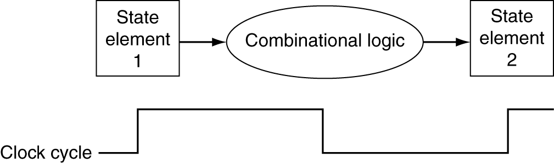
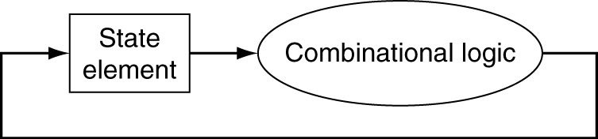
Clocking Methodology
Combinational logic transforms data during clock cycles
Between clock edges
Input from state elements, output to state element
Longest delay determines clock period

Slide 17
Building a Datapath
Datapath
Elements that process data and addresses in the CPU
Registers, ALUs, mux’s, memories, …
We will build a MIPS datapath incrementally
Refining the overview design
§4.3 Building a Datapath

Slide 18
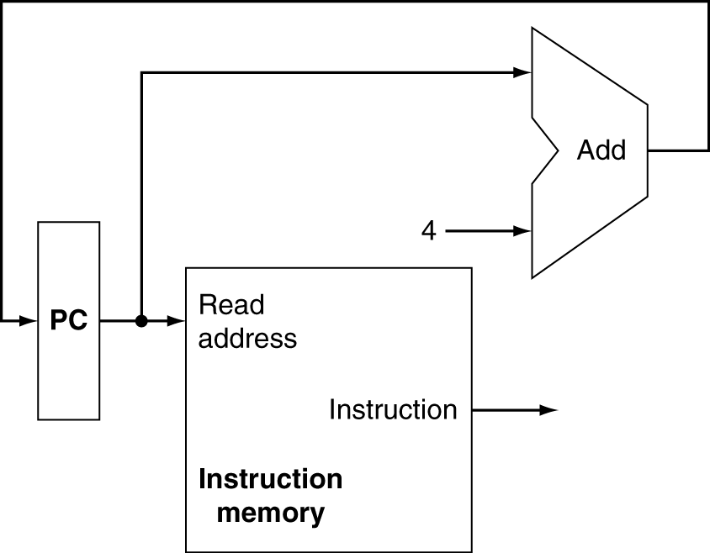
Instruction Fetch
Increment by 4 for next instruction
32-bit register
Program counter + Instruction memory + Adder

Slide 19
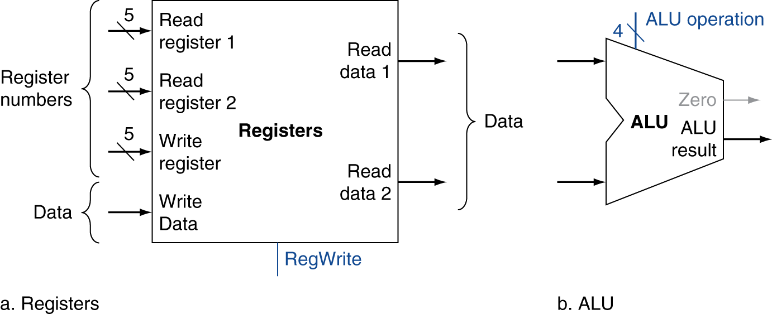
R-Format Instructions
Read two register operands
Perform arithmetic/logical operation
Write register result
R instruction class includes: add, sub, AND, OR, slt, …
Notes:
Zero is 1-bit signal, indicate when the result is 0.

Slide 20
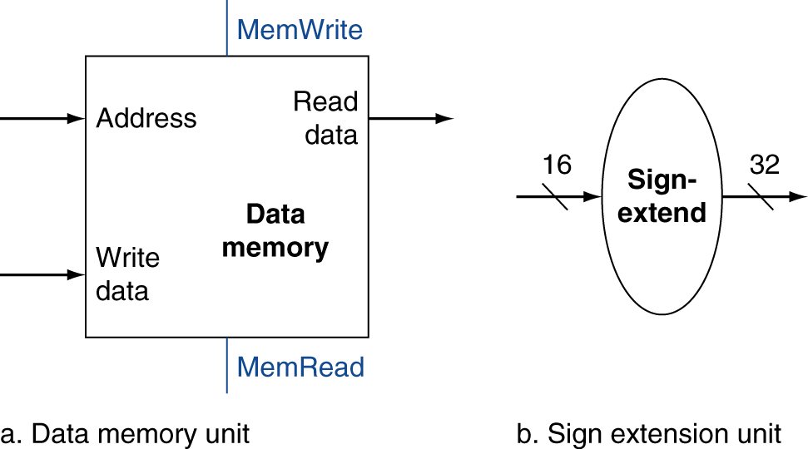
Load/Store Instructions
General form of load/store:
lw $t1, offset_value($t2) # load word; offset is of 16 bits
sw $t1, offset_value($t2) # store word; $t2 is the base reg.
Read register operands
Calculate address using 16-bit offset
Use ALU, but sign-extend offset
Load: Read memory and update register
Store: Write register value to memory

Slide 21
Branch Instructions
Example: beq $t1, $t2, offset # 16-bits offset
Read register operands
Compare operands
Use ALU, subtract and check Zero output
Calculate target address
Sign-extend displacement
Shift left 2 places (word displacement)
Add to PC + 4
Already calculated by instruction fetch

Slide 22
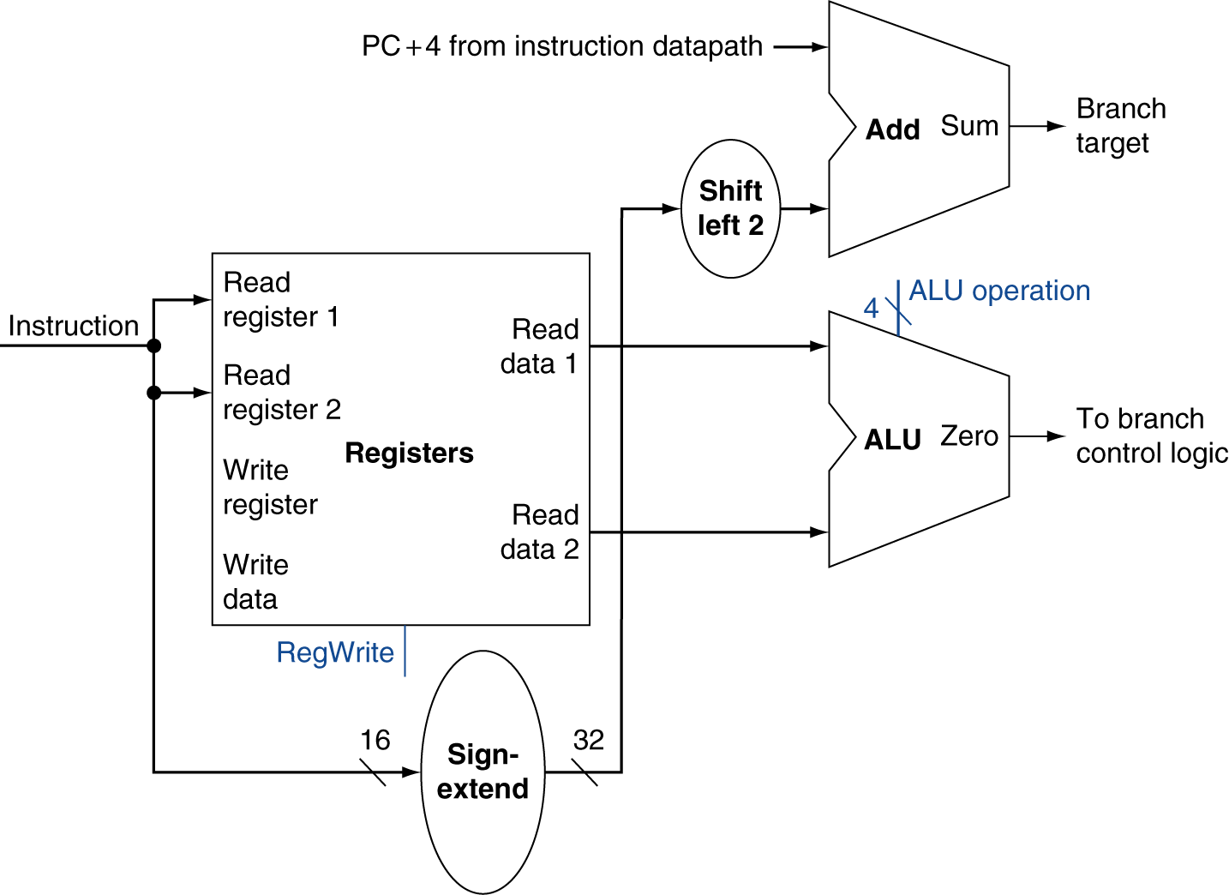
Branch Instructions
Separate adder
Just re-routes wires
Need to do 2 operations:
Compute the branch target address.
Compare the register contents.
Sign-bit wire replicated

Slide 23
Composing the Elements
First-cut data path does an instruction in one clock cycle
Each datapath element can only do one function at a time
Hence, we need separate instruction and data memories
Use multiplexers where alternate data sources are used for different instructions

Slide 24
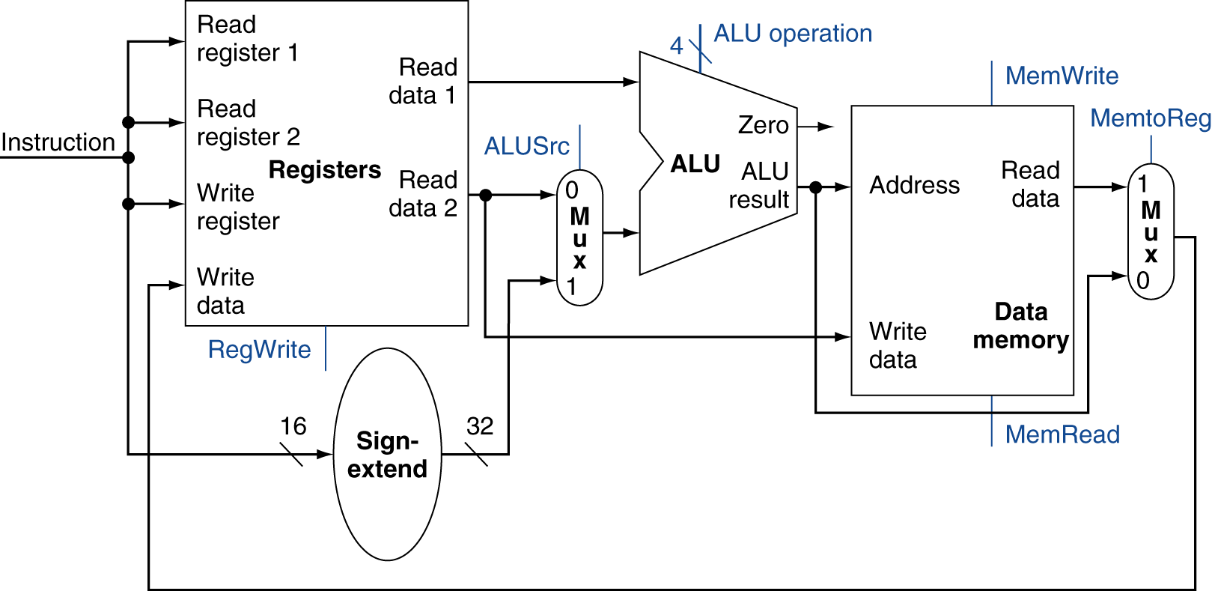
R-Type/Load/Store Datapath
While instruction/1 clock cycle: no datapath resource can be used more than once per instruction,
so any element needed more than once must be duplicated.
Thus, we need a memory for instructions separate from one for data.

Slide 25
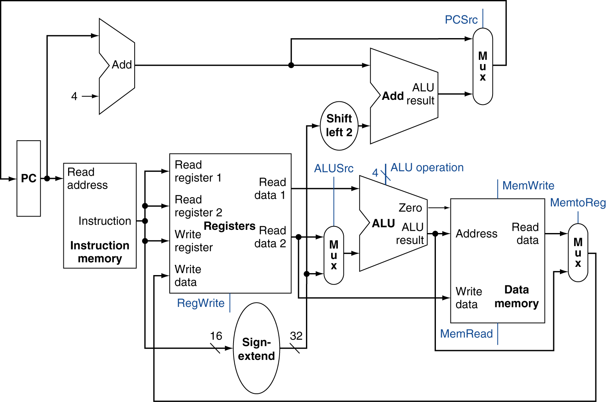
Full Datapath

Slide 26
Control
Slide 13 – Recall
Notes:
Note: Zero output in ALU indicates if all Result lines have value 0 (See appendix B for more)

Slide 27
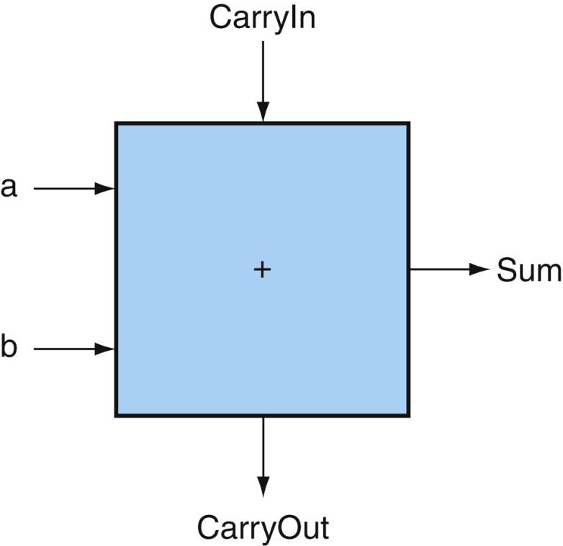
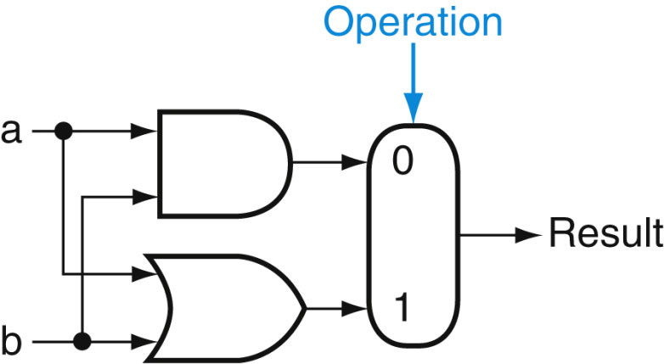
Building ALU & its Control
We construct a simple ALU from 5 basic hardwares:
AND & OR gates, inverters, multiplexors and full adder
In reality, ALU contains more hardware e.g. multiplication
(Read Appendix B for more details)
FIGURE 2: A 1-bit adder. This adder is called a full adder; it is also called a (3,2) adder because it has 3 inputs and 2 outputs. An adder with only the a and b inputs is called a (2,2) adder or half-adder.
FIGURE 1: The 1-bit logical unit for AND and OR.

Slide 28
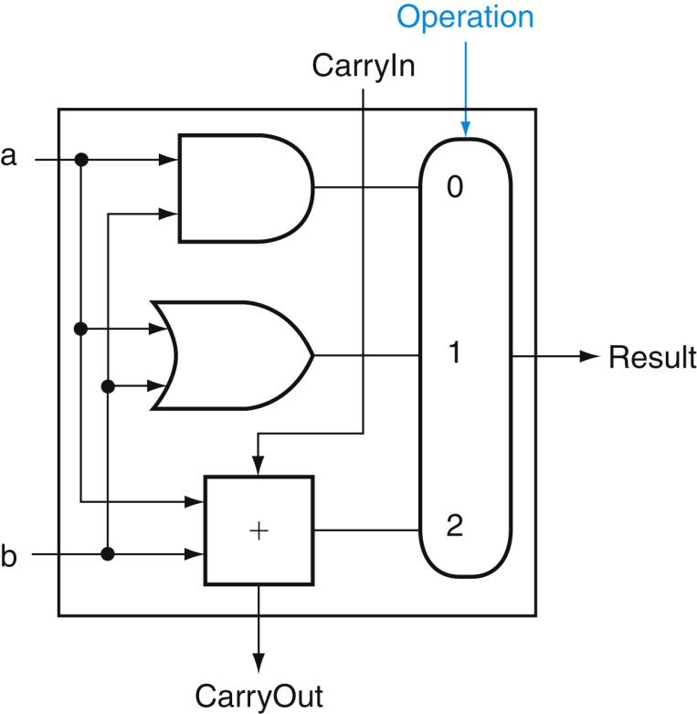
… Building ALU & its Control
A 1 bit ALU that performs:
AND, OR and Addition
Operation: => Control
AND=> 00
OR => 01
Add => 10
Figure: A 1-bit ALU that performs AND, OR, and Addition and selection them with control bits 00, 01 and 10 respectively.

Slide 29
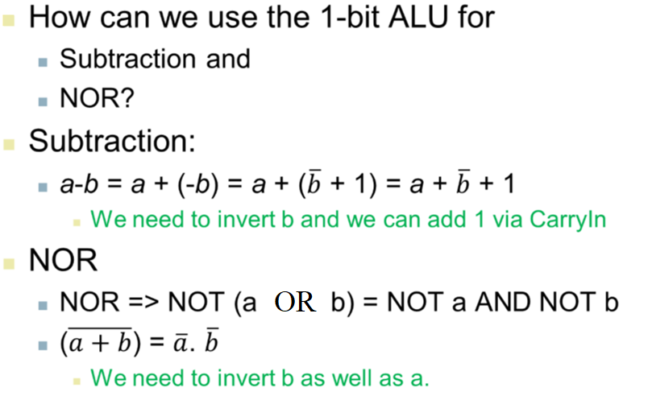
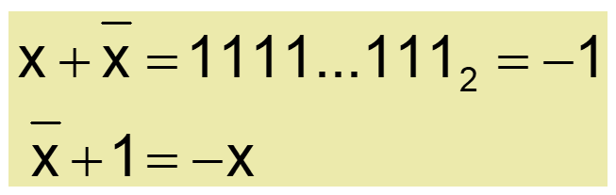
… Building ALU & its Control
Remember 2’s complement

Slide 30
… Building ALU & its Control

Slide 31
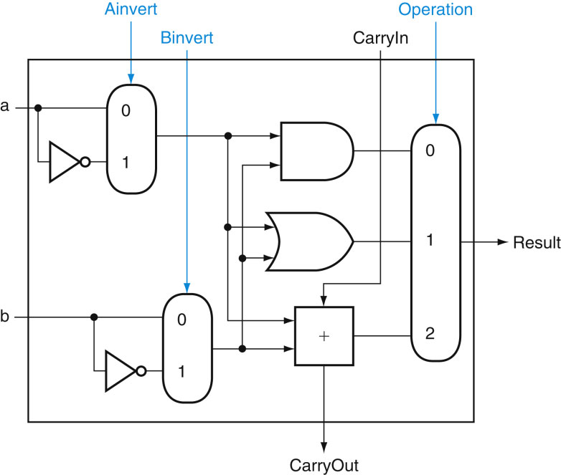
… Building ALU & its Control

Slide 32
… Building ALU & its Control
Set Less Than (slt) Function:
e.g. slt $t0, $t1, $t2 # if t1 < t2 then t0 = 1 else t0 = 0
Defined as:
000 … 001 or, 1 for A < B
A slt B =
000 … 000 or, 0 for A ≥ B
Logic: When subtract b from a, if the difference is negative then a < b, since (a-b) < 0.
We want the LSB of slt operation to be ‘1’ if (a-b) < 0 and ‘0’ otherwise.
Output:

Slide 33
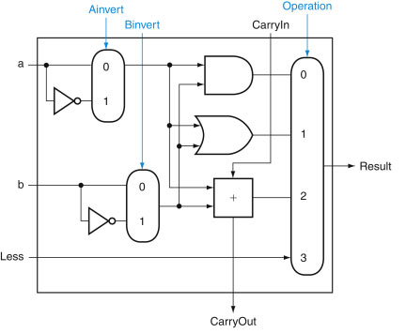
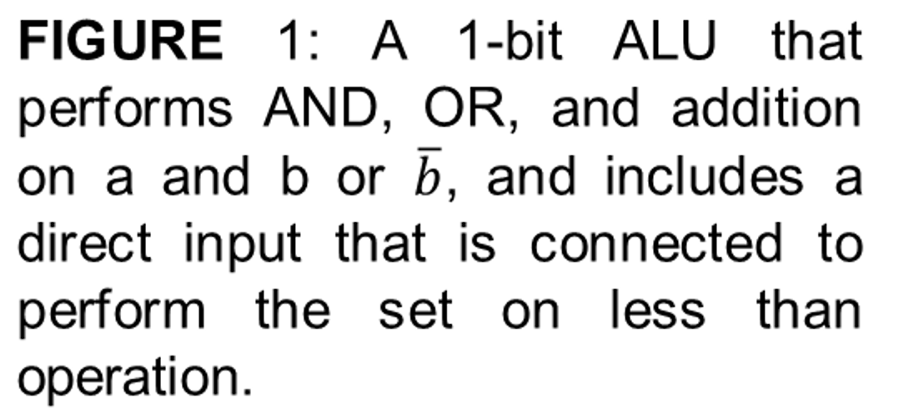
… Building ALU & its Control

Slide 34
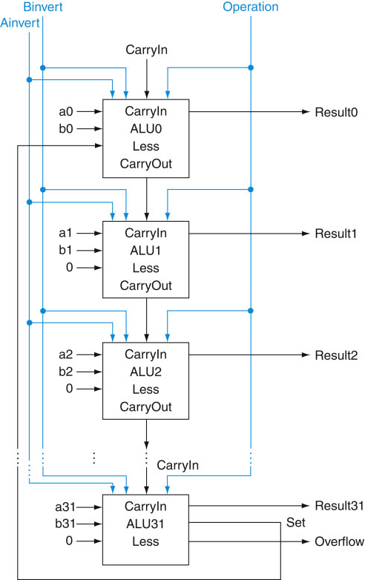
… Building ALU & its Control
32 bit slt:
A 32-bit ALU constructed from the 31 copies of the 1-bit ALU in Figure 1 of previous slide and one 1-bit ALU in Figure 2 of previous slide.
All the ‘Less’ inputs are connected to 0 except for the least significant bit, which is connected to the ‘Set’ output of the most significant bit.
If the ALU performs (a – b) and we select the input 3 in the multiplexor as shown in the Figure, then Result = 000 … 001 if a < b, and Result = 000 … 000 otherwise.
Note:
Every time we want the ALU to subtract, we set both CarryIn and Binvert to 1.
For add or logic operation we want both CarryIn and Binvert to 0.

Slide 35
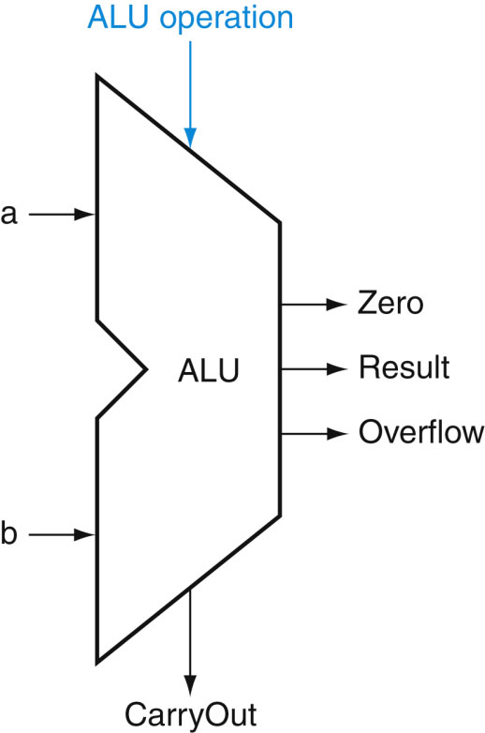
ALU Control
ALU used for the following functions (F):
ALU control | Function
0000 | AND
0001 | OR
0010 | add
0110 | subtract
0111 | set-on-less-than
1100 | NOR
§4.4 A Simple Implementation Scheme
To choice the above R-Type functions (except NOR), the three ALU control lines, Ainvert, Bnegate, and the operations are used.
For lw/sw add is used to compute the memory address.
For branch equal (beq), the ALU performs a subtraction.

Slide 36
The Main Control Unit
Control signals derived from instruction
R-type
0
rs
rt
rd
shamt
funct
31:26
25:21
20:16
15:11
10:6
5:0
Load/ Store
35 or 43
rs
rt
address
(type i)
31:26
25:21
20:16
15:0
Branch
4
rs
rt
address
(type i)
31:26
25:21
20:16
15:0
(dest.)
Base reg.
opcode
always read
read, except for load
write for R-type and load
sign-extend and add
Notes:
Note: (dest.)
For load instruction the destination register’s bit positions are 20:16 (rt), while for an R-type instruction it is in bit positions 15:11 (rd).
Thus we will need a multiplexor to select which field of the instruction is used to indicate the register number to be written.

Slide 37
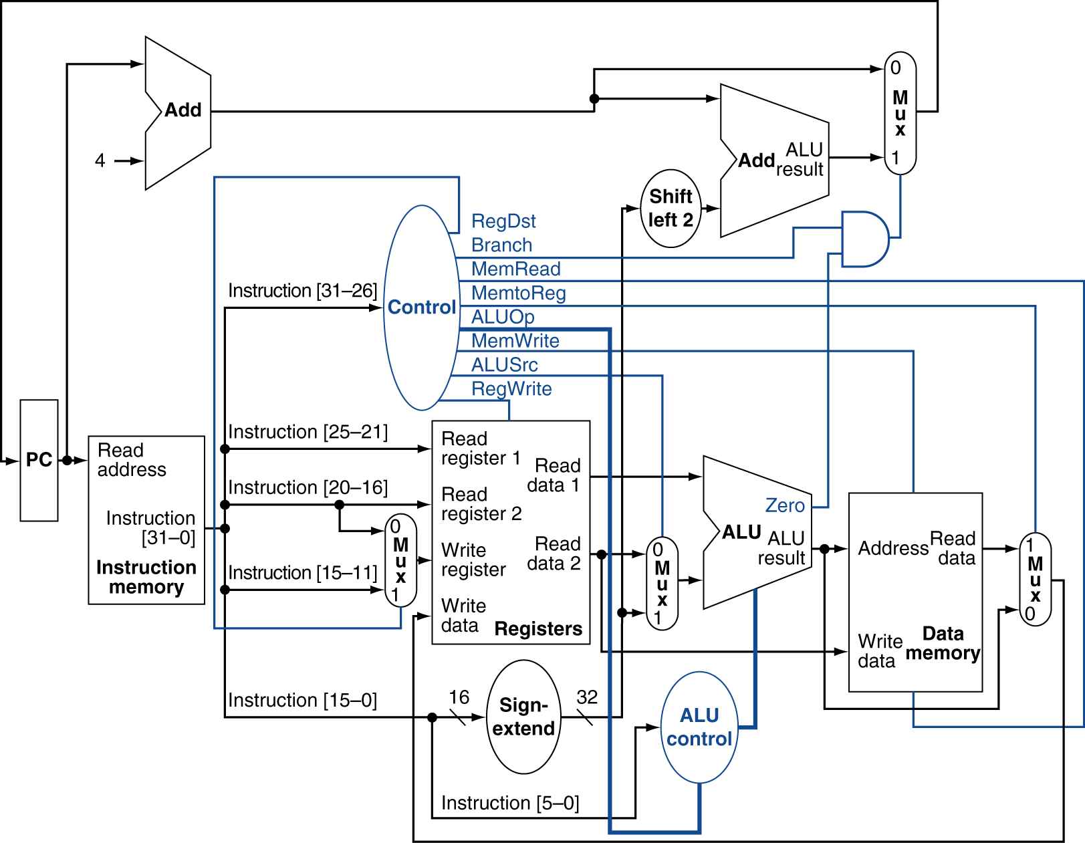
Datapath With Control

Slide 38
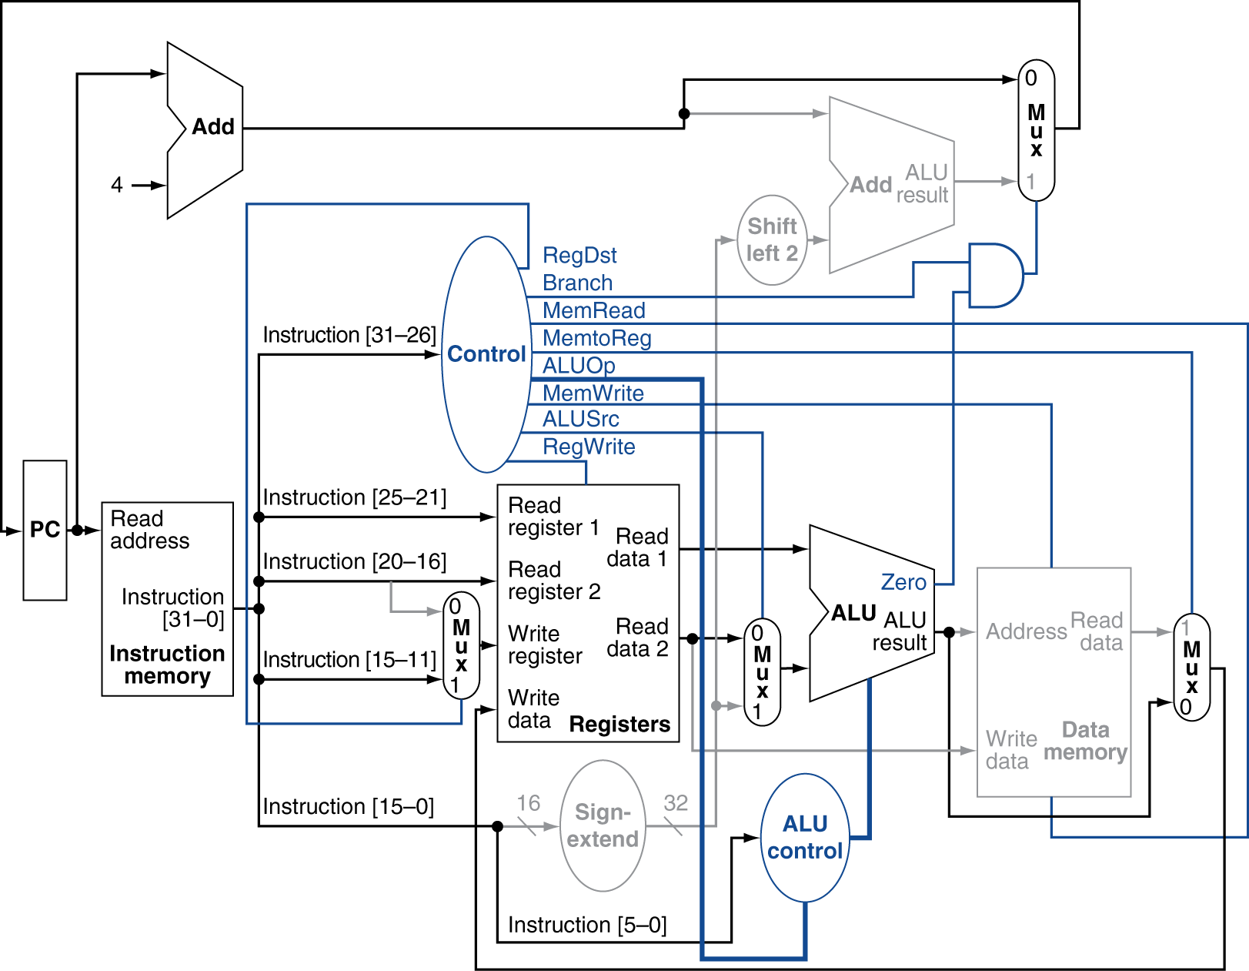
R-Type Instruction

Slide 39
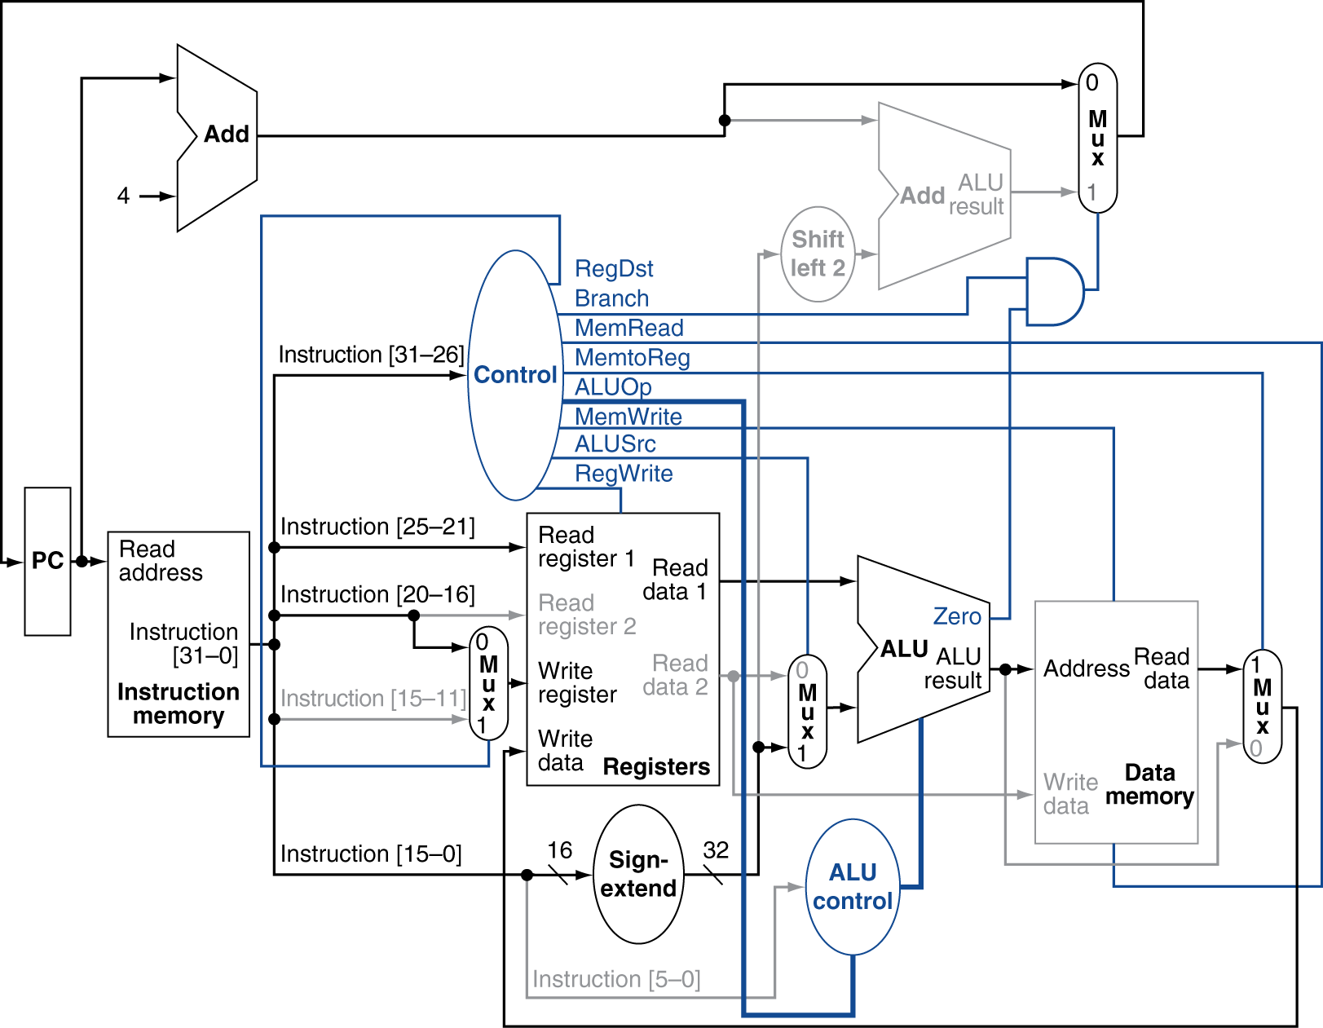
Load Instruction

Slide 40
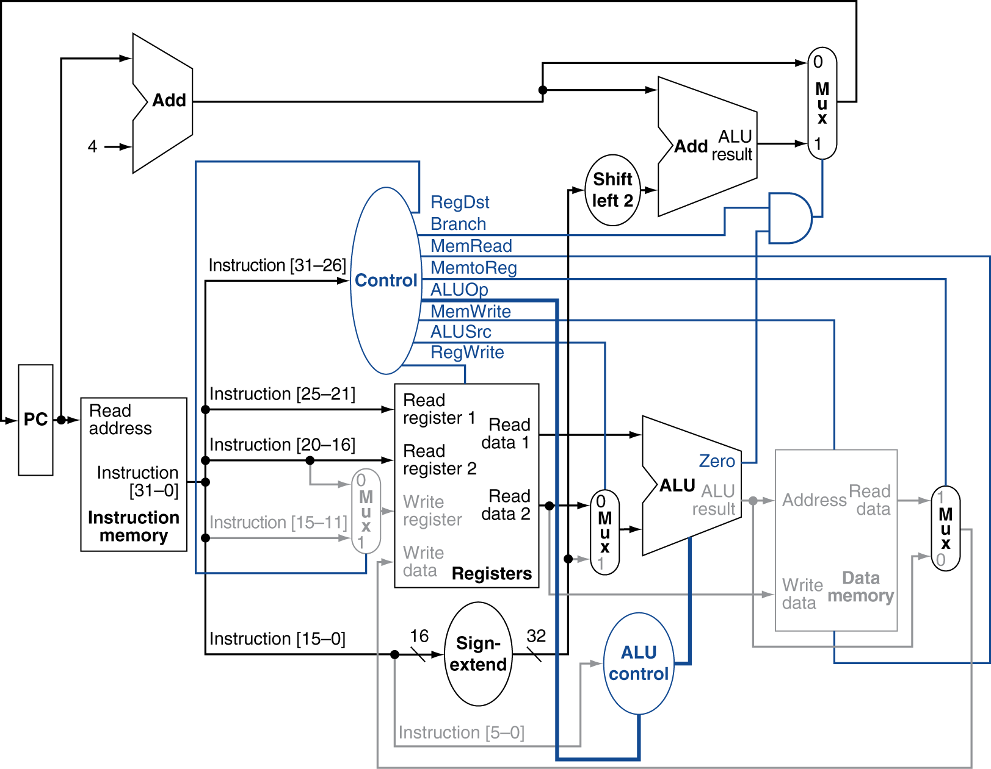
Branch-on-Equal Instruction

Slide 41
Implementing Jumps
Jump
2
address
31:26
25:0
Jump uses word address
Update PC with concatenation of
Top 4 bits of current PC+4
26-bit jump address
00
Need an extra control signal decoded from opcode

Slide 42
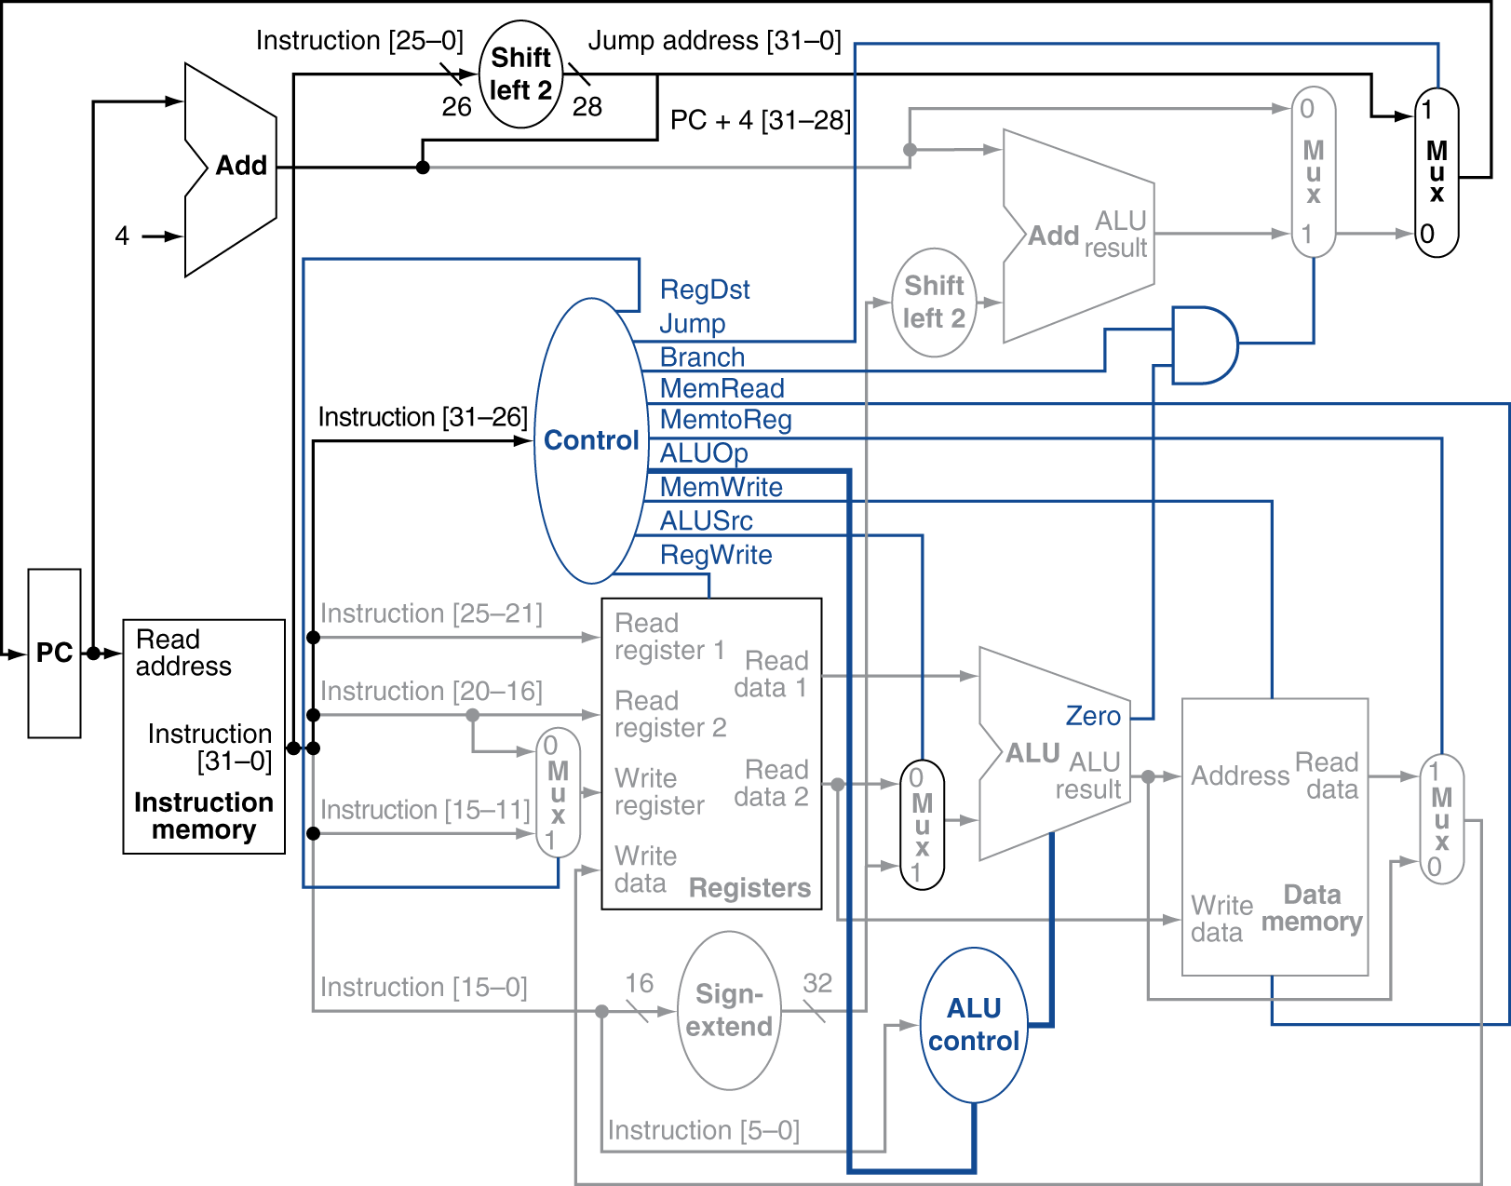
Datapath With Jumps Added

Slide 43
Performance Issues
Longest delay determines clock period
Critical path: load instruction
Instruction memory → register file → ALU → data memory → register file
Not feasible to vary period for different instructions
Violates design principle
Making the common case fast
We will improve performance by pipelining

Slide 44
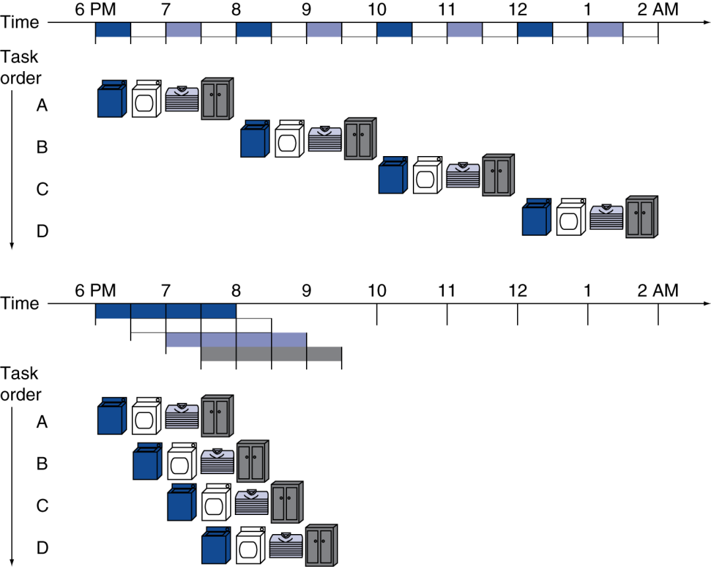
Pipelining Analogy
Pipelined laundry: overlapping execution
Parallelism improves performance
§4.5 An Overview of Pipelining
Four loads:
Speedup = 8/3.5 = 2.29
Non-stop:
Speedup ≈ 4 = number of stages
Notes:
Sequential 4 loads take 8 hrs., whereas the 4 loads in pipeline take 3.5 hrs. So the speedup is 8/3.5 = 2.29.

Slide 45
MIPS Pipeline
Five stages, one step per stage
IF: Instruction fetch from memory
ID: Instruction decode & register read
EX: Execute operation or calculate address
MEM: Access memory operand
WB: Write result back to register

Slide 46
Pipeline Performance
Assume time for stages is
100ps for register read or write
200ps for other stages
Compare pipelined datapath with single-cycle datapath
Instr | Instr fetch | Register read | ALU op | Memory access | Register write | Total time
lw | 200ps | 100 ps | 200ps | 200ps | 100 ps | 800ps
sw | 200ps | 100 ps | 200ps | 200ps |  | 700ps
R-format | 200ps | 100 ps | 200ps |  | 100 ps | 600ps
beq | 200ps | 100 ps | 200ps |  |  | 500ps

Slide 47
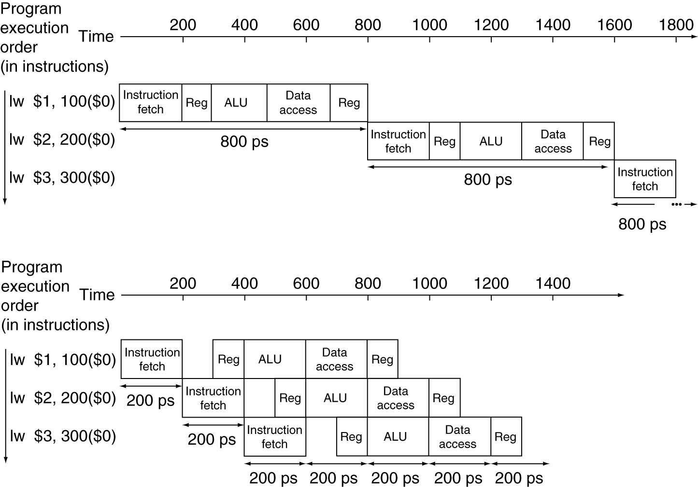
Pipeline Performance
Single-cycle (T_{c}= 800ps)
Pipelined (T_{c}= 200ps)
Important: We assume, that the register file is read during the second half of the clock cycle and the register file is written in the first half of the clock cycle.
Notes:
Important Note:
We assume, that the register file is read during the second half of the clock cycle and the register file is written in the first half of the clock cycle.

Slide 48
Pipeline Speedup
If all stages are balanced
i.e., all take the same time
Time between instructions_{pipelined} = Time between instructions_{nonpipelined} Number of stages
If not balanced, speedup is less
Speedup due to increased throughput
Latency (time for each instruction) does not decrease

Slide 49
Pipelining and ISA Design
MIPS ISA designed for pipelining
All instructions are 32-bits
Easier to fetch and decode in one cycle
c.f. x86: 1- to 17-byte instructions
Few and regular instruction formats
Can decode and read registers in one step
Load/store addressing
Can calculate address in 3rd stage, access memory in 4th stage
Alignment of memory operands
Memory access takes only one cycle

Slide 50
Hazards
Situations that prevent starting the next instruction in the next cycle
Structure hazards
A required resource is busy
Data hazard
Need to wait for previous instruction to complete its data read/write
Control hazard
Deciding on control action depends on previous instruction

Slide 51
Structure Hazards
Conflict for use of a resource
Assume, you have a washer & dryer combined machine instead of separate. So, your cannot do both the job in parallel.
In MIPS pipeline with a single memory
Load/store requires data access
Instruction fetch would have to stall for that cycle
Would cause a pipeline “bubble”
Hence, pipelined datapaths require separate instruction/data memories
Or separate instruction/data caches
Notes:
Structural Hazard => When a planned instruction cannot execute in the proper clock cycle because the hardware does not support the combination of instructions that are set to execute.

Slide 52
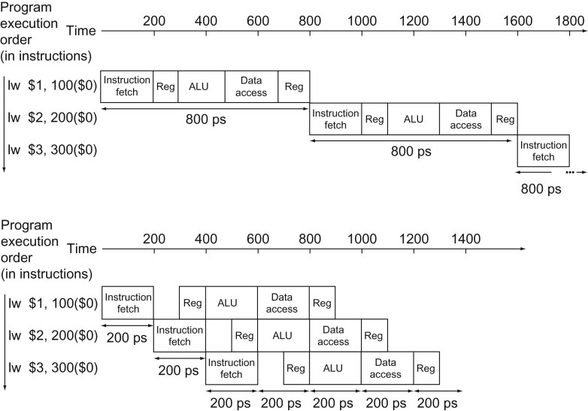
Structure Hazards
1st instruction
4th instruction
With the 4th instruction, we see that in the same clock cycle:
(1) the 1st instruction is accessing data from memory (highlighted green) while if
(2) the 4th instruction is fetching instruction from the same memory (highlighted red)
that would have caused structural hazard.
Notes:
Structural Hazard => When a planned instruction cannot execute in the proper clock cycle because the hardware does not support the combination of instructions that are set to execute.

Slide 53
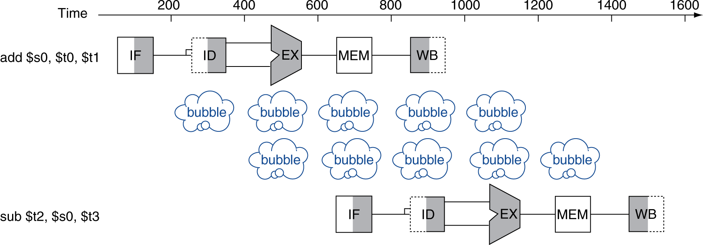
Data Hazards
An instruction depends on completion of data access by a previous instruction
add $s0, $t0, $t1 sub $t2, $s0, $t3
Notes:
Note:
White Box => Not in use by the instruction.
Box with shed in the Right part => (used and ) a read operation.
Box with shed in the Left part => (used and ) a write operation.
Grey Box / Shaded Box => in use.

Slide 54
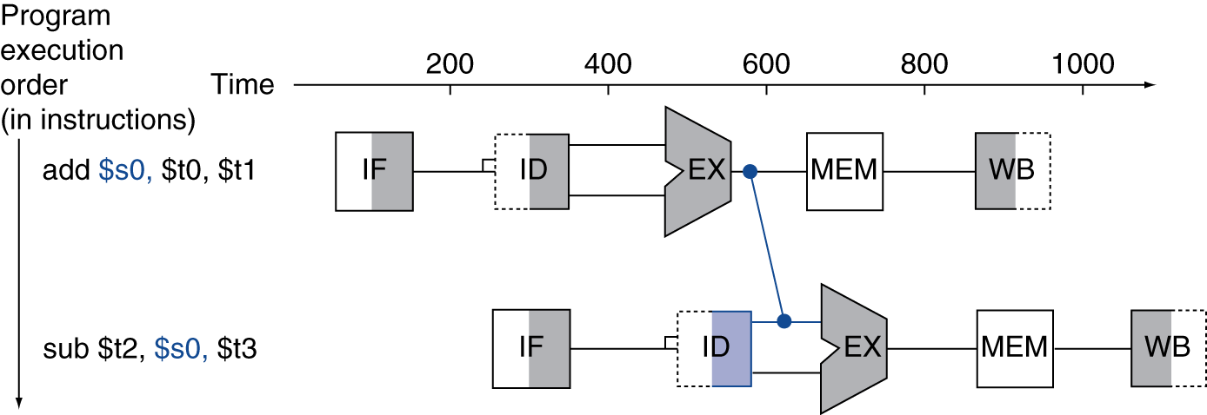
Forwarding (aka Bypassing)
Use result when it is computed
Don’t wait for it to be stored in a register
Requires extra connections in the datapath

Slide 55
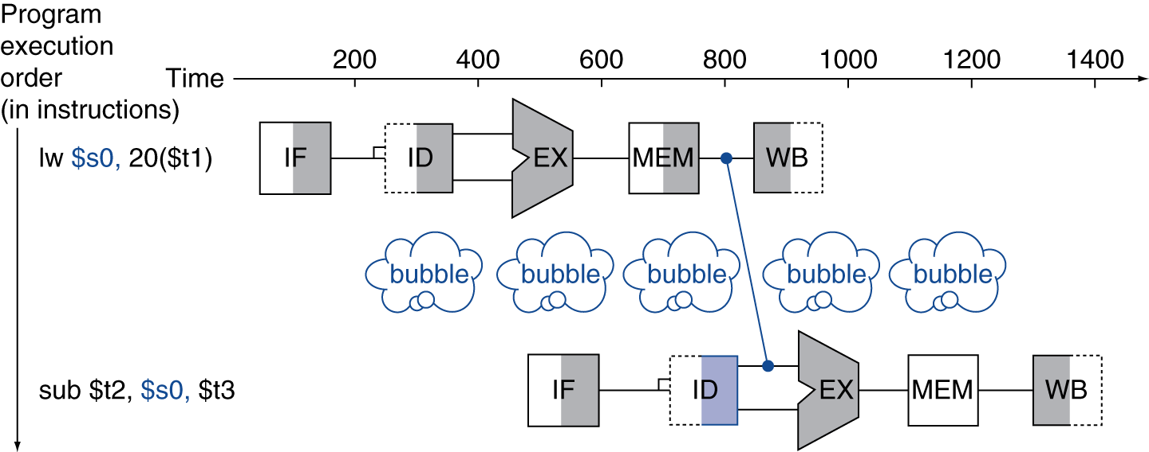
Load-Use Data Hazard
Can’t always avoid stalls by forwarding
If value not computed when needed
Can’t forward backward in time!
Unavoidable Stall

Slide 56
Code Scheduling to Avoid Stalls
Reorder code to avoid use of load result in the next instruction
C code for A = B + E; C = B + F;
lw $t1, 0($t0)
lw $t2, 4($t0)
add $t3, $t1, $t2
sw $t3, 12($t0)
lw $t4, 8($t0)
add $t5, $t1, $t4
sw $t5, 16($t0)
lw $t1, 0($t0)
lw $t2, 4($t0)
lw $t4, 8($t0)
add $t3, $t1, $t2
sw $t3, 12($t0)
add $t5, $t1, $t4
sw $t5, 16($t0)
stall
stall
13 cycles
11 cycles
Notes:
Looking at the code we can say:
B is in memory location 0($t0);
E is in memory location 4($t0);
A is in memory location 12($t0);
F is in memory location 8($t0);
C is in memory location 16($t0);

Slide 57
Control Hazards
Branch determines flow of control
Fetching next instruction depends on branch outcome
Pipeline can’t always fetch correct instruction
Still working on ID stage of branch
In MIPS pipeline
Need to compare registers and compute target early in the pipeline
Add hardware to do it in ID stage

Slide 58
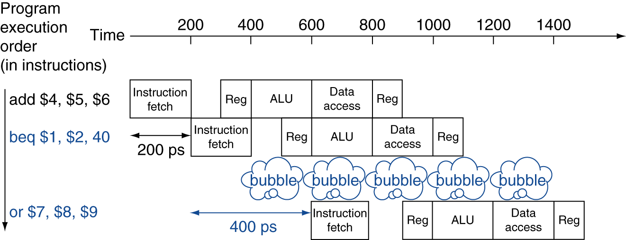
Stall on Branch
Wait until branch outcome determined before fetching next instruction

Slide 59
Branch Prediction
Longer pipelines can’t readily determine branch outcome early
Stall penalty becomes unacceptable
Predict outcome of branch
Only stall if prediction is wrong
In MIPS pipeline
Can predict branches not taken
Fetch instruction after branch, with no delay

Slide 60
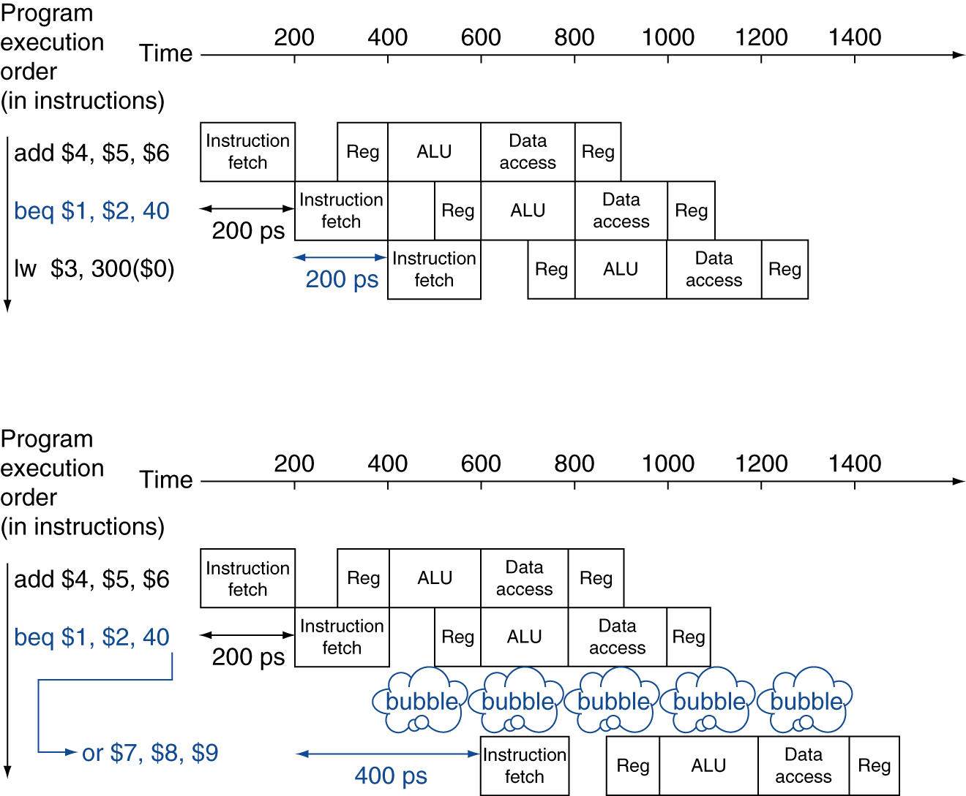
MIPS with Predict Not Taken
Prediction correct
Prediction incorrect

Slide 61
More-Realistic Branch Prediction
Static branch prediction
Based on typical branch behavior
Example: loop and if-statement branches
Predict backward branches taken
Predict forward branches not taken
Dynamic branch prediction
Hardware measures actual branch behavior
e.g., record recent history of each branch
Assume future behavior will continue the trend
When wrong, stall while re-fetching, and update history

Slide 62
Pipeline Summary
The BIG Picture
Pipelining improves performance by increasing instruction throughput
Executes multiple instructions in parallel
Each instruction has the same latency
Subject to hazards
Structure, data, control
Instruction set design affects complexity of pipeline implementation

Slide 63
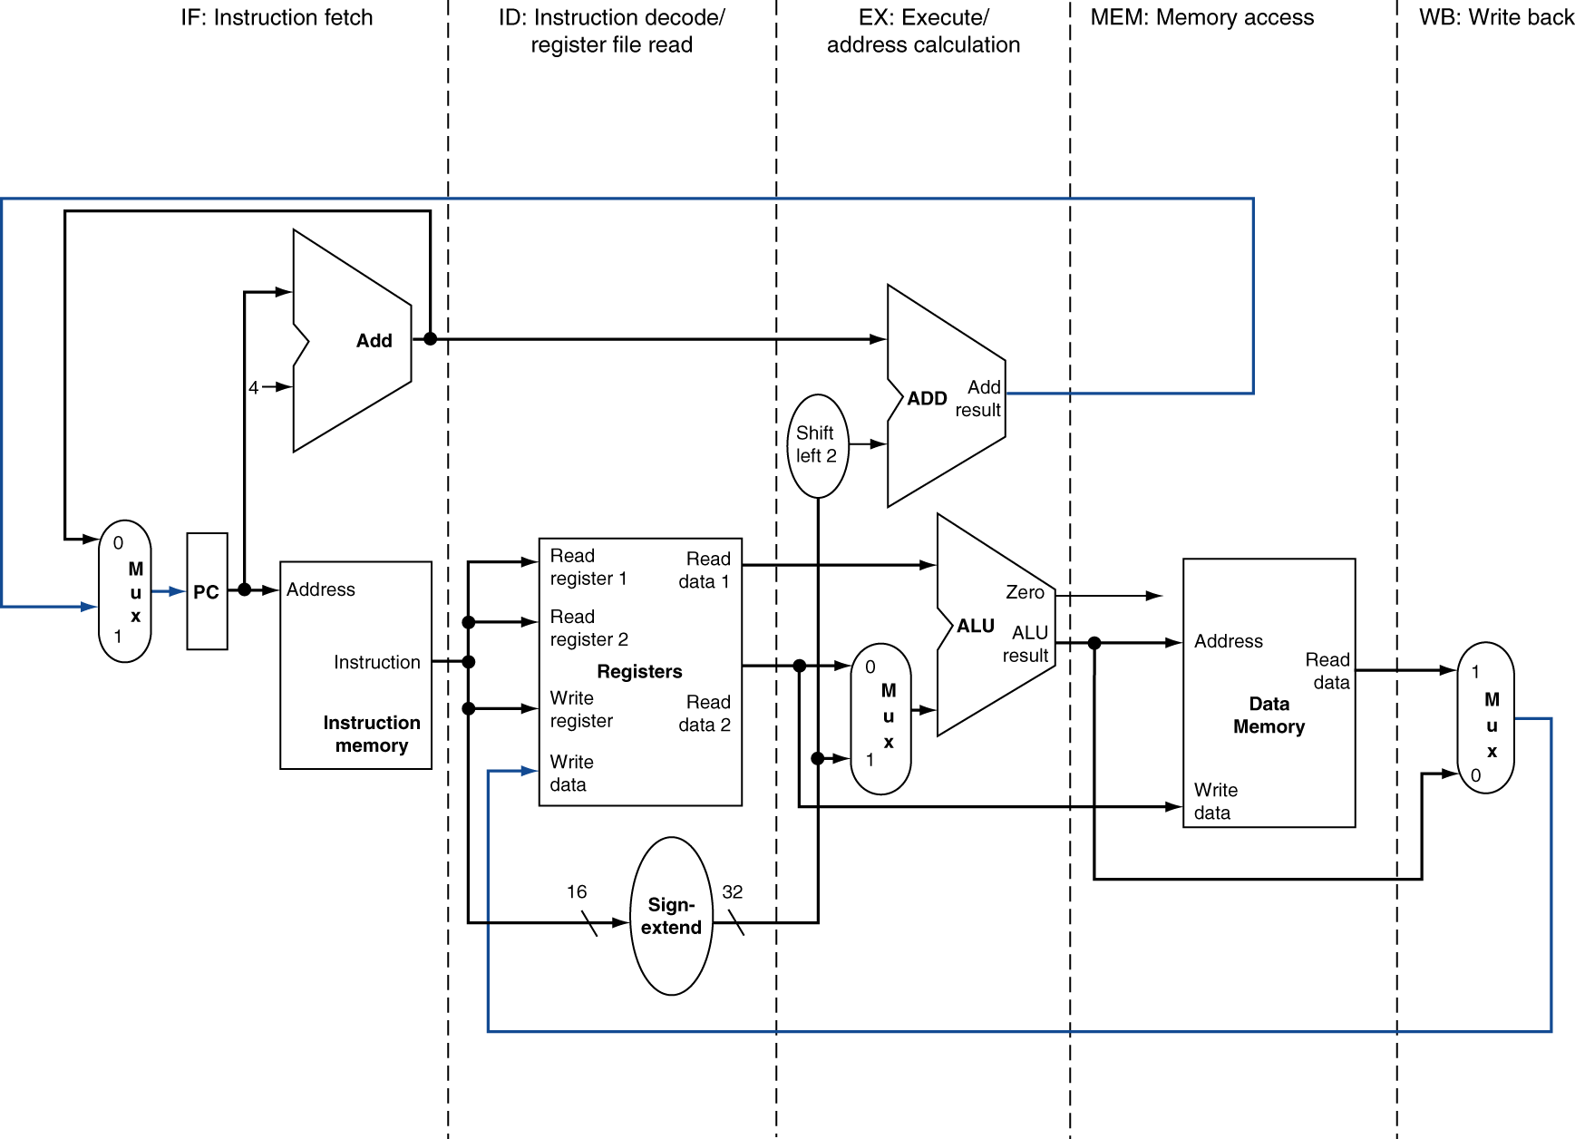
MIPS Pipelined Datapath
§4.6 Pipelined Datapath and Control
MEM
Right-to-left flow leads to hazards
WB
Notes:
Note: Flow from right to left (R-L) is a problem for the next instruction. And there are two R-L flows:
WB to Reg: can cause data hazard
PC1 to PC2: can lead to control hazard

Slide 64
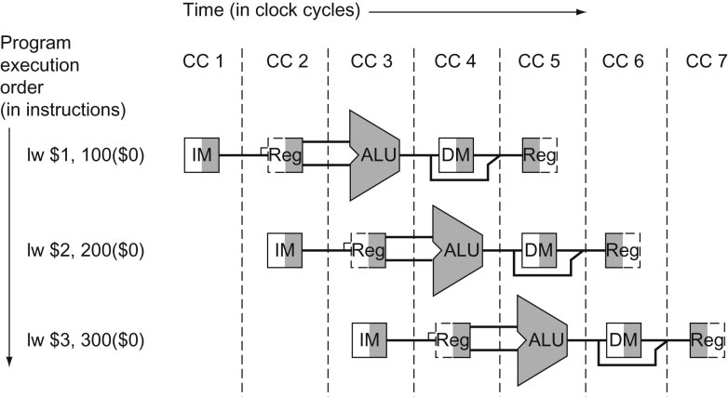
MIPS Pipelined Datapath
Figure: each instruction has its own data-path, and shades each portion according to use. Each stage is labeled by the physical resource
IM represents the instruction memory and the PC in the instruction fetch stage,
Reg stands for the register file and sign extender in the instruction decode/register file read stage (ID), and so on.
§4.6 Pipelined Datapath and Control
Note: To maintain proper time order, the datapath breaks the register file into two logical parts: registers read during register fetch (ID) and registers written during write back (WB). We already assumed that the register file is written in the first half of the clock cycle and the register file is read during the second half.
Main Message:
The figure above seems to suggest that the 3 separate instructions need 3 private datapath – instead, we add register to hold data so that portions of a single datapath can be shared during instruction executions.

Slide 65
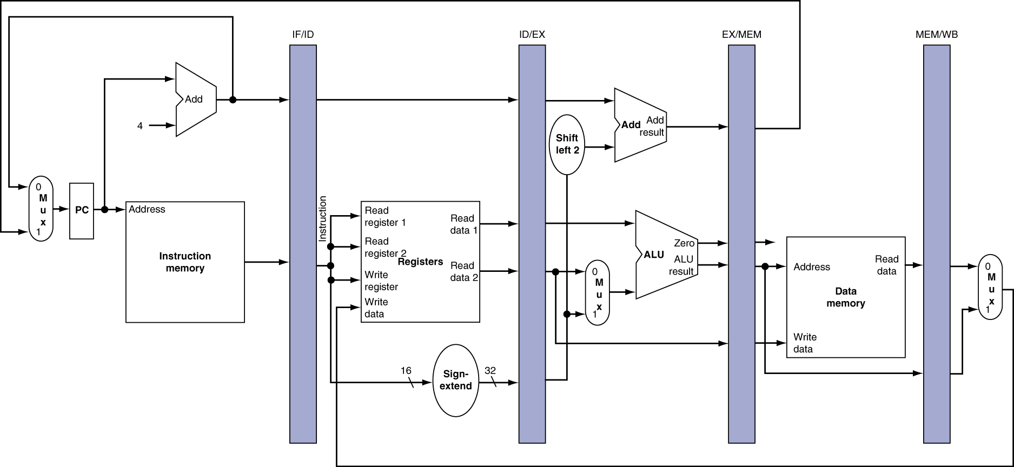
Pipeline registers
Need registers between stages
To hold information produced in previous cycle
Notes:
Q1: Why there is no pipeline register at the end of the write-back (WB) state?
A1: All instructions must update some stage in the processor, such as, register file, memory, or the PC – so a separate pipeline register is redundant to the state that is updated.
For example, a load instruction will place its result in 1 of 32 registers, and any later instruction that needs that data will simply read the appropriate register.
Of course, PC can be thought of a pipeline register: every instruction updates the PC, whether by incrementing it or by setting it to branch destination address.

Slide 66
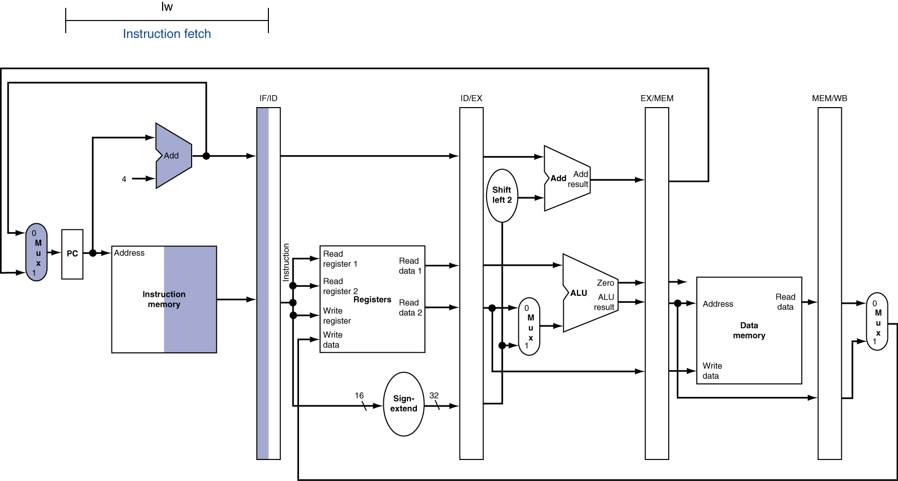
IF for Load, Store, …

Slide 67
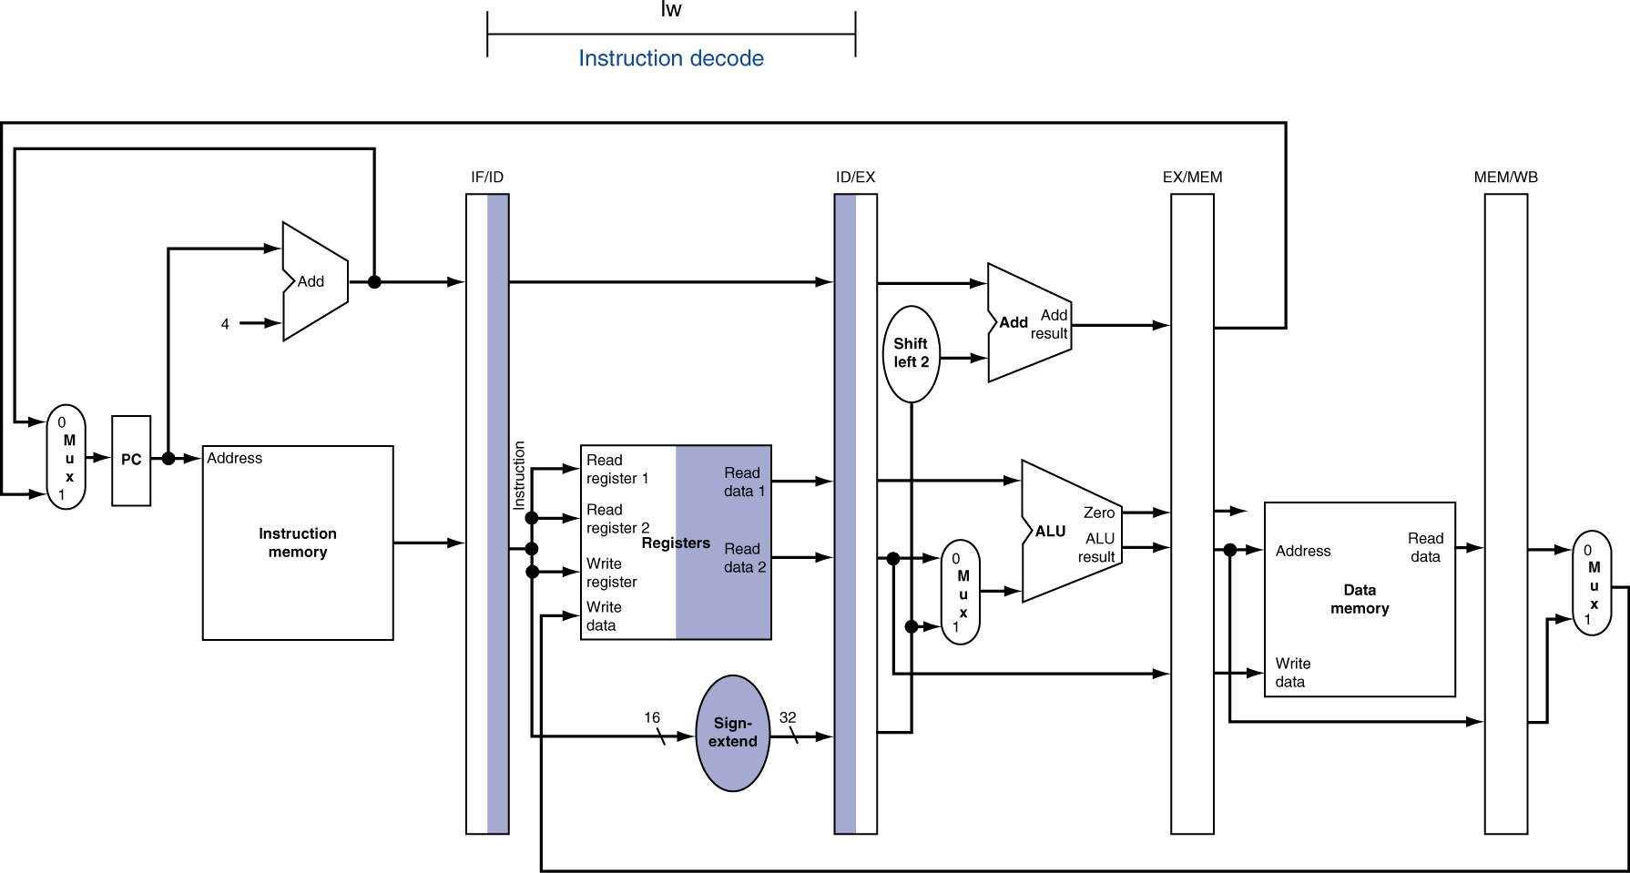
ID for Load, Store, …

Slide 68
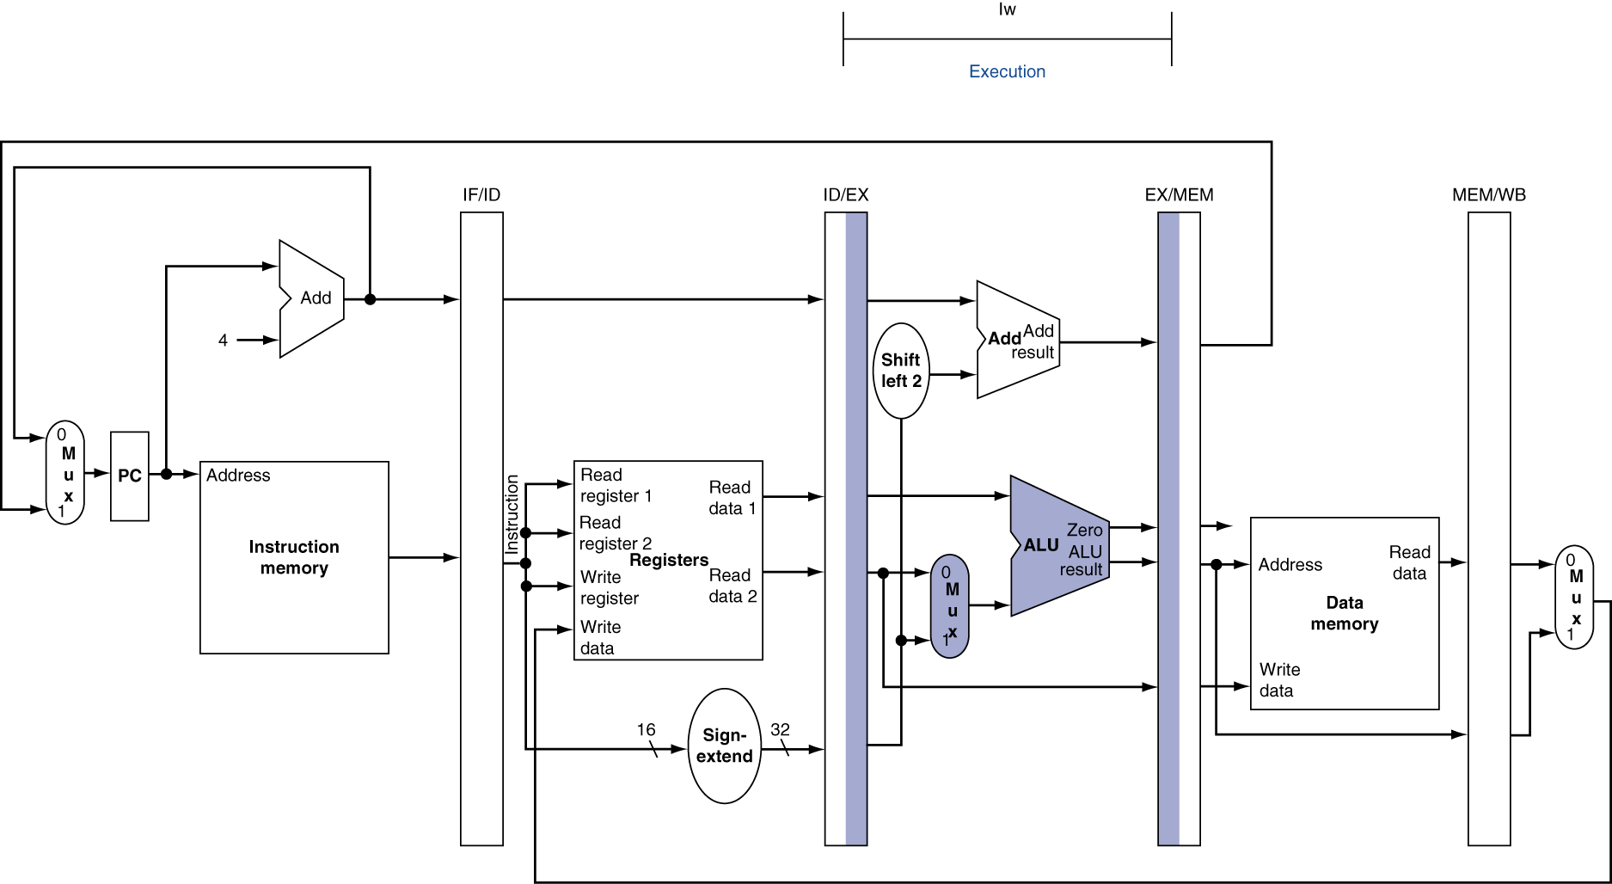
EX for Load

Slide 69
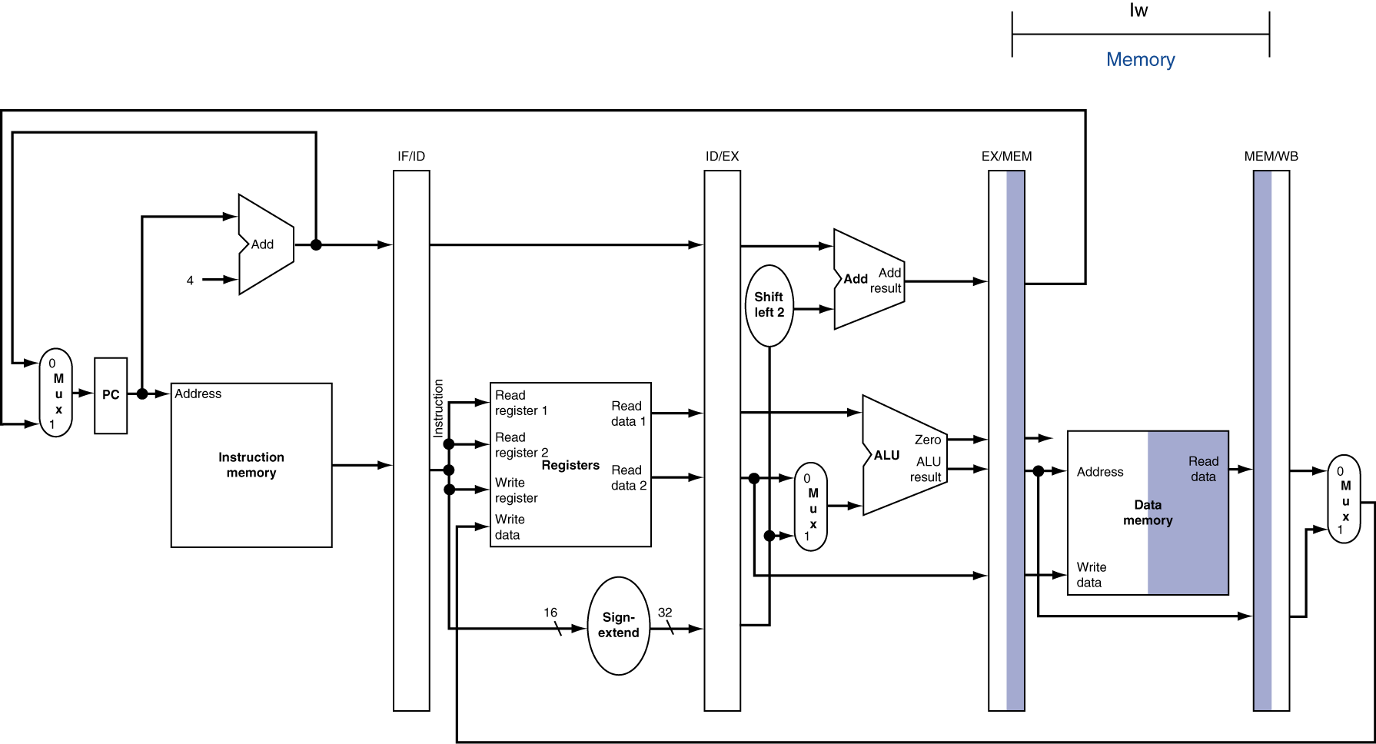
MEM for Load

Slide 70
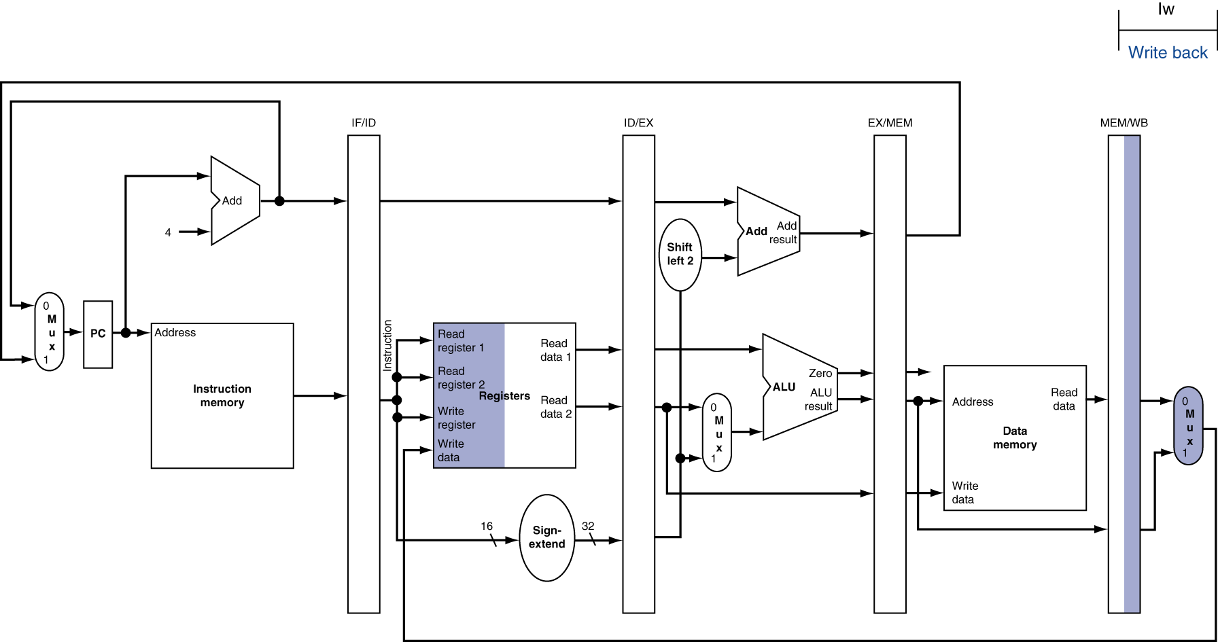
WB for Load
Wrong register number

Slide 71
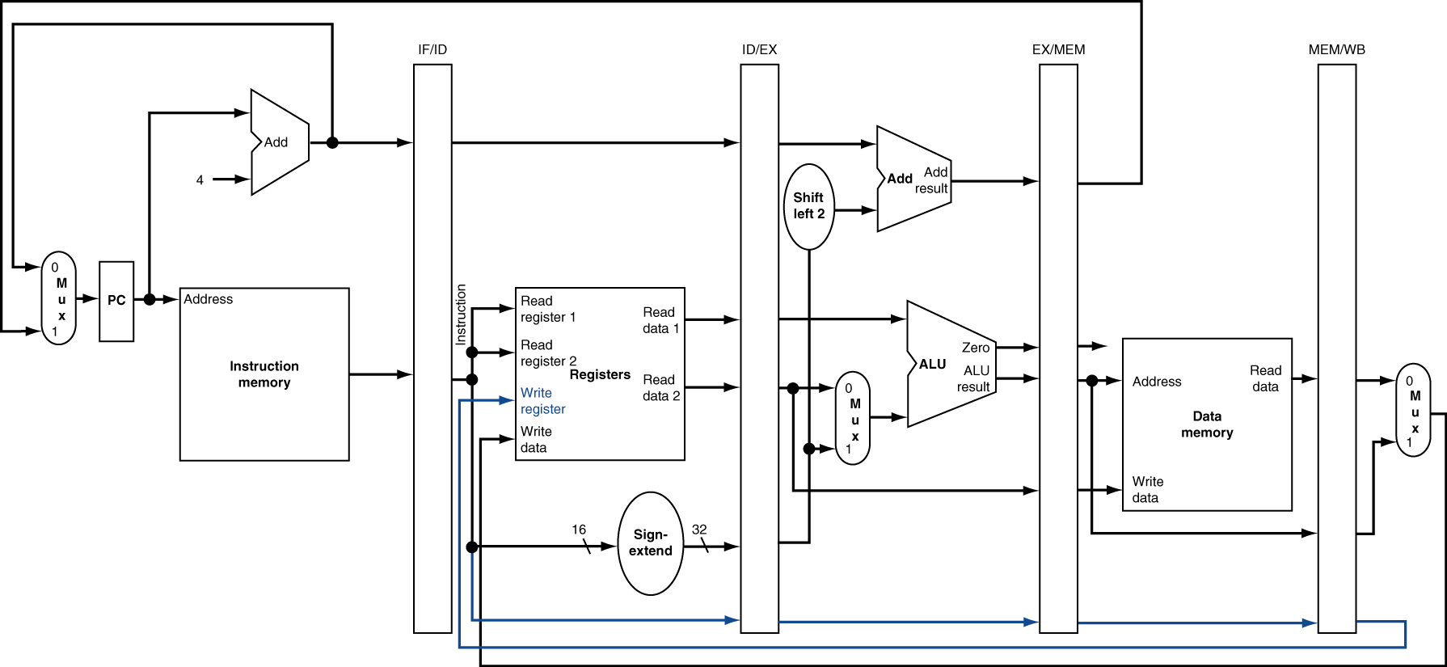
Corrected Datapath for Load

Slide 72

EX for Store

Slide 73
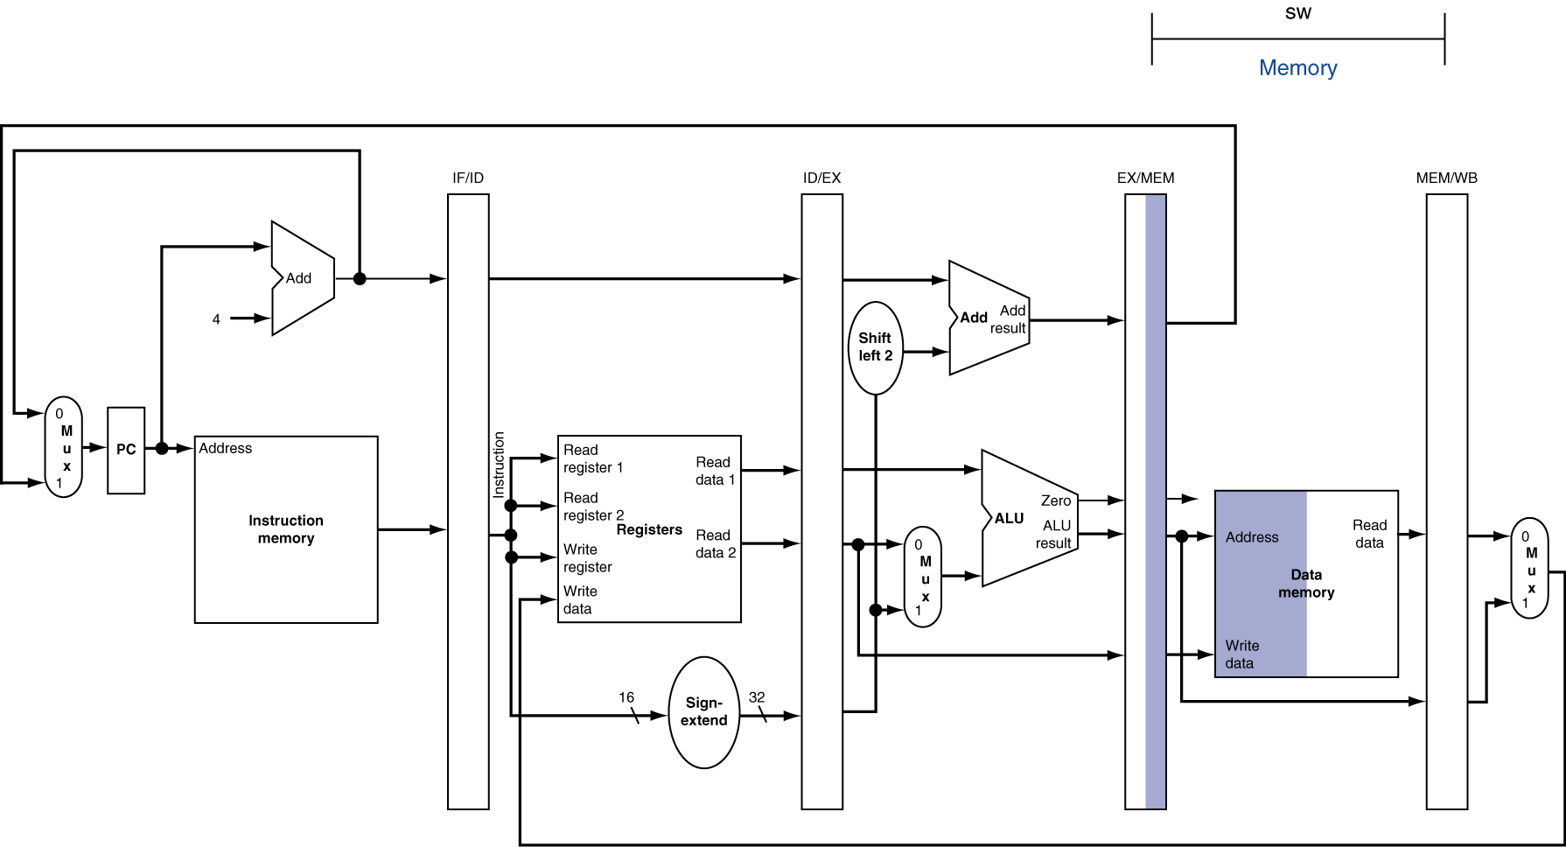
MEM for Store

Slide 74
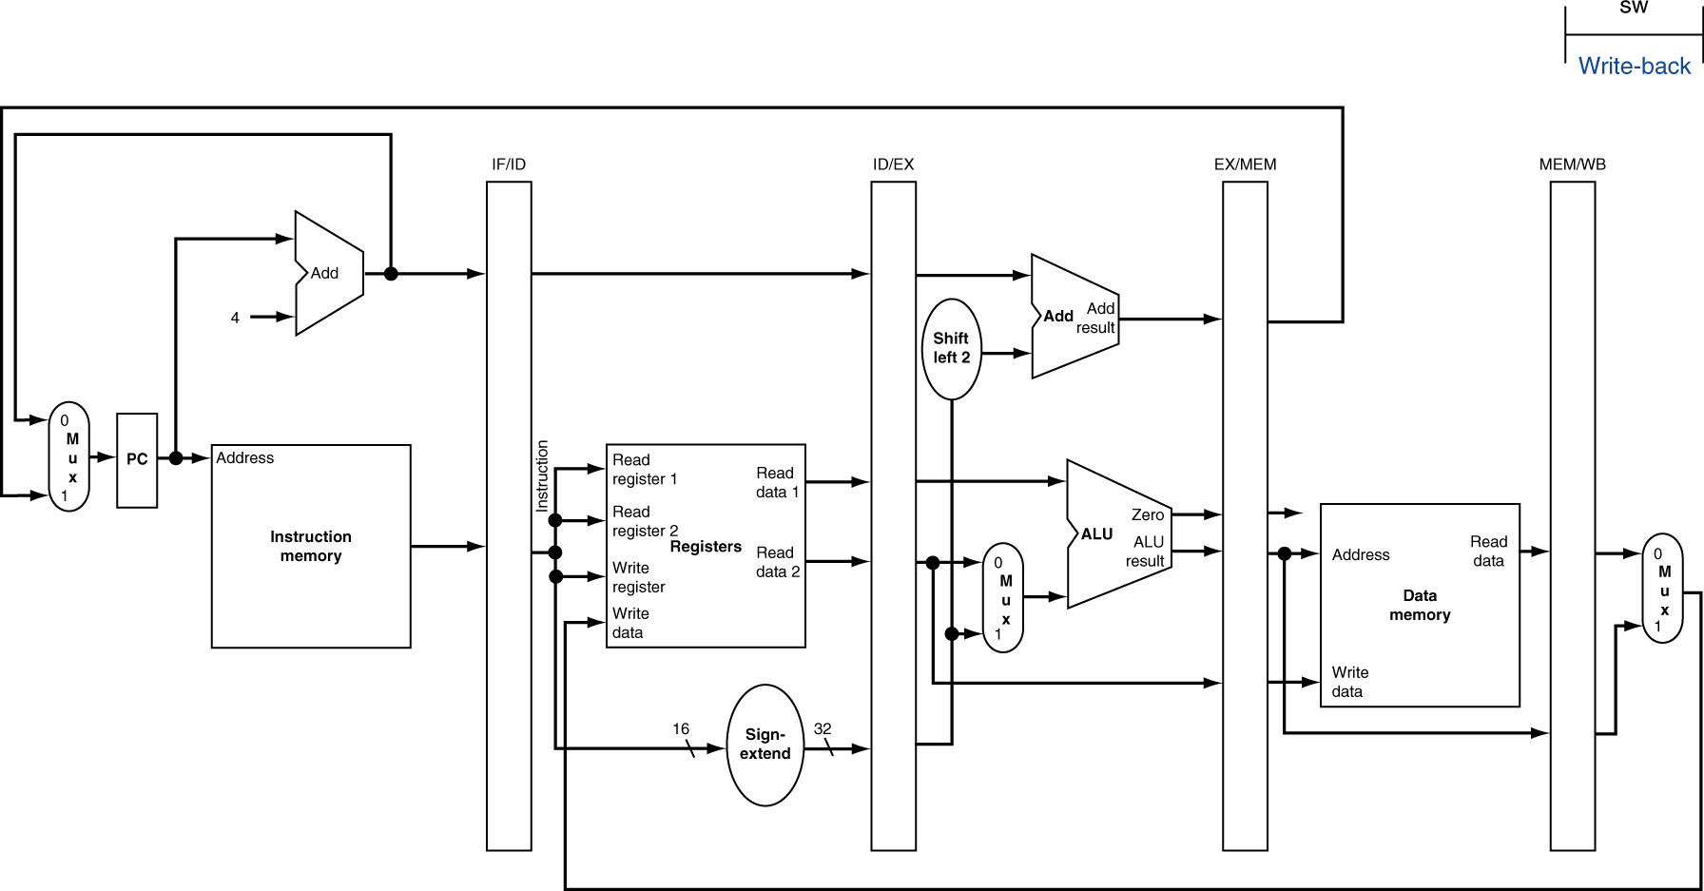
WB for Store
Note: 5th stage (WB) is doing nothing for SW’s execution.

Slide 75
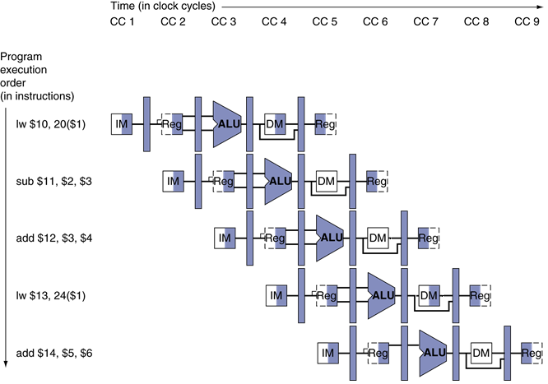
Multi-Cycle Pipeline Diagram
Form showing resource usage

Slide 76

Multi-Cycle Pipeline Diagram
Traditional form

Slide 77

Single-Cycle Pipeline Diagram
State of pipeline in a given cycle

Slide 78

Pipelined Control (Simplified)

Slide 79

Pipelined Control
Control signals derived from instruction
As in single-cycle implementation

Slide 80

Pipelined Control

Slide 81
Data Hazards in ALU Instructions
Consider this sequence:
sub $2, $1,$3 # Reg. $2 written by sub and $12,$2,$5 # 1st operand ($2) depends on sub or $13,$6,$2 # 2nd operand ($2) depends on sub add $14,$2,$2 # 1st ($2) & 2nd ($2) depend on sub sw $15,100($2) # Base ($2) depends on sub
We can resolve hazards with forwarding
How do we detect when to forward?
§4.7 Data Hazards: Forwarding vs. Stalling
Notes:
Note:
** All the last 4 instructions are dependent on the result in register $2 of the first instruction.
** If register $2 had a value 10 before the subtract instruction and became -20 afterwards, the programmer intends that -20 will be used in the following instructions that refer to register $2.

Slide 82

Dependencies & Forwarding
Notes:
Assume the value of $2 was 10 before and -20 after the execution of the 1st instruction.
Red connections are forwarding – which is a solution here without stall.

Slide 83

Dependencies & Forwarding
Figure 1: (a) The dependences between the pipeline registers move forward in time, so it is possible to supply the inputs to the ALU needed by the AND instruction and OR instruction by forwarding the results found in the pipeline registers.
Figure 1: (b) The values in the pipeline registers show that the desired value is available before it is written into the register file.
Figure 1: (c) We assume that the register file forwards values that are read and written during the same clock cycle, so the add does not stall, but the values come from the register file instead of a pipeline register. Register file “forwarding”—that is, the read gets the value of the write in that clock cycle—is why clock cycle 5 shows register $2 having the value 10 at the beginning and −20 at the end of the clock cycle. As in the rest of this section, we handle all forwarding except for the value to be stored by a store instruction.

Slide 84
Detecting the Need to Forward
Self Study
Pass register numbers along pipeline
e.g., ID/EX.RegisterRs = register number for Rs sitting in ID/EX pipeline register
ALU operand register numbers in EX stage are given by
ID/EX.RegisterRs, ID/EX.RegisterRt
Data hazards when
1a. EX/MEM.RegisterRd = ID/EX.RegisterRs
1b. EX/MEM.RegisterRd = ID/EX.RegisterRt
2a. MEM/WB.RegisterRd = ID/EX.RegisterRs
2b. MEM/WB.RegisterRd = ID/EX.RegisterRt
Fwd from EX/MEM pipeline reg
Fwd from MEM/WB pipeline reg
Notes:
How does the forwarding work?
For simplicity, we consider only the challenge of forwarding to an operations in the EX stage, which may be either an ALU operation or an effective address calculation.
This means that when an instruction is trying to use the register in its EX usage than an earlier instruction intends to write in its WB stage, we actually need the values as inputs to the ALU.
(solution) A notation that names the fields of the pipeline registers allows for a more precise notation of dependences. E.g., “ID/EX.RegistersRs” refers to one of the register whose value is found in the pipeline register ID/EX, related to the first read port of the register file.

Slide 85
Detecting the Need to Forward
Self Study
But only if forwarding instruction will write to a register!
EX/MEM.RegWrite, MEM/WB.RegWrite
And only if Rd for that instruction is not $zero
EX/MEM.RegisterRd ≠ 0, MEM/WB.RegisterRd ≠ 0
Finally, for an EX hazard we can have a forwarding unit which can check & do the following:
If (EX/MEM.RegWrite and (EX/MEM.RegRd ≠ 0) and (EX/MEM.RegRd = ID/EX.RegRs))
then ForwardA = 10₂
If (EX/MEM.RegWrite and (EX/MEM.RegRd ≠ 0) and (EX/MEM.regRd = ID/EX.RegRt))
then ForwardB = 10₂

Slide 86

Forwarding Paths

Slide 87
Forwarding Conditions
Self Study
EX hazard
if (EX/MEM.RegWrite and (EX/MEM.RegisterRd ≠ 0) and (EX/MEM.RegisterRd = ID/EX.RegisterRs)) ForwardA = 10
if (EX/MEM.RegWrite and (EX/MEM.RegisterRd ≠ 0) and (EX/MEM.RegisterRd = ID/EX.RegisterRt)) ForwardB = 10
MEM hazard
if (MEM/WB.RegWrite and (MEM/WB.RegisterRd ≠ 0) and (MEM/WB.RegisterRd = ID/EX.RegisterRs)) ForwardA = 01
if (MEM/WB.RegWrite and (MEM/WB.RegisterRd ≠ 0) and (MEM/WB.RegisterRd = ID/EX.RegisterRt)) ForwardB = 01

Slide 88

Forwarding Conditions
Self Study
Summary of the control values for Mux:
FIGURE : The control values for the forwarding multiplexors

Slide 89
Double Data Hazard
Re-check
Consider the sequence:
add $1,$1,$2 add $1,$1,$3 add $1,$1,$4
Both hazards occur
Want to use the most recent
Revise MEM hazard condition
Only fwd if EX hazard condition isn’t true

Slide 90
Revised Forwarding Condition
Self Study
MEM hazard
if (MEM/WB.RegWrite and (MEM/WB.RegisterRd ≠ 0) and not (EX/MEM.RegWrite and (EX/MEM.RegisterRd ≠ 0) and (EX/MEM.RegisterRd = ID/EX.RegisterRs)) and (MEM/WB.RegisterRd = ID/EX.RegisterRs)) ForwardA = 01
if (MEM/WB.RegWrite and (MEM/WB.RegisterRd ≠ 0) and not (EX/MEM.RegWrite and (EX/MEM.RegisterRd ≠ 0) and (EX/MEM.RegisterRd = ID/EX.RegisterRt)) and (MEM/WB.RegisterRd = ID/EX.RegisterRt)) ForwardB = 01

Slide 91

Datapath with Forwarding

Slide 92

Load-Use Data Hazard
Need to stall for one cycle
As we have discussed before, the forwarding cannot save us when an instruction tries to read a register following a load instruction that writes the same register.
Thus, in addition to a forwarding unit, we need a hazard detection unit.
Notes:
Note: As we have discussed before, the forwarding cannot save us when an instruction tries to read a register following a load instruction that writes the same register.
Thus, in addition to a forwarding unit, we need a hazard detection unit.

Slide 93
Load-Use Hazard Detection
Self Study
Check when using instruction is decoded in ID stage
ALU operand register numbers in ID stage are given by
IF/ID.RegisterRs, IF/ID.RegisterRt
Load-use hazard when
ID/EX.MemRead and ((ID/EX.RegisterRt = IF/ID.RegisterRs) or (ID/EX.RegisterRt = IF/ID.RegisterRt))
If detected, stall (one cycle) and insert bubble, (after 1 cycle of stall forwarding will take care).
Make sure this is a ‘load’
Notes:
Note: The only instruction that reads from memory is the ‘load’.

Slide 94
How to Stall the Pipeline
Force control values in ID/EX register to 0
EX, MEM and WB do nop (no-operation)
Prevent update of PC and IF/ID register
By instruction is decoded again
Following instruction is fetched again
1-cycle stall allows MEM to read data for lw
Can subsequently forward to EX stage

Slide 95

Stall/Bubble in the Pipeline
Stall inserted here

Slide 96

Datapath with Hazard Detection

Slide 97
Stalls and Performance
The BIG Picture
Stalls reduce performance
But are required to get correct results
Compiler can arrange code to avoid hazards and stalls
Complier requires knowledge of the pipeline structure

Slide 98

Control / Branch Hazards
Self Study
§4.8 Control Hazards
If branch outcome determined in MEM
7
Flush these instructions
(Set control values to 0)
PC
Notes:
Figure shows a sequence of instructions and indicates when the branch would occur in this pipeline.
(Without any treatment) in our design and decision about whether to branch doesn’t occur until the MEM pipeline stage.
Compared to the data hazards this control or branch hazards are relatively simple to understand and they occur relatively less frequently.
There is nothing as effective against control hazards as forwarding is against data hazards.
We look at 2 schemes for resolving control hazards and one optimization to improve these schemes.

Slide 99
Branch Hazards
Self Study
§4.8 Control Hazards
Compared to the data hazards this control or branch hazards are relatively simple to understand and they occur relatively less frequently.
There is nothing as effective against control hazards as forwarding is against data hazards.
We look at 2 schemes for resolving control hazards and one optimization to improve these schemes.

Slide 100
Reducing Branch Delay
Self Study
Move hardware to determine outcome to ID stage [ => reduce stall from 3 to 1 cycles]
Target address adder
Register comparator [XORing operands, then ORing results]
Example: branch taken
36: sub $10, $4, $8 40: beq $1, $3, 7 44: and $12, $2, $5 48: or $13, $2, $6 52: add $14, $4, $2 56: slt $15, $6, $7 ... 72: lw $4, 50($7)
Notes:
Note:

Slide 101

Example: Branch Taken
Self Study

Slide 102

Example: Branch Taken
Self Study

Slide 103
Reducing Branch Delay
Self Study
Move hardware to determine outcome to ID stage [ => reduce stall from 3 to 1 cycles]
Target address adder
Register comparator [XORing operands, then ORing results]
If the branch is ‘NOT Taken’ then we do not even have this 1 cycle bubble or penalty.
Thus the assumption (prediction) of ‘Taken’ or ‘NOT Taken’ is better than waiting for the branch result and then to proceed.
We call this slot, which is possibly having 1 cycle penalty, a ‘Delayed Slot’.
Notes:
Note:

Slide 104

Scheduling the branch delay slot
Self Study
Notes:
Scheduling the branch delay slot.
The top box in each pair shows the code before scheduling; the bottom box shows the scheduled code.
In (a), the delay slot is scheduled with an independent instruction from before the branch. This is the best choice.
Strategies (b) and (c) are used when (a) is not possible. In the code sequences for (b) and (c), the use of $s1 in the branch condition prevents the add instruction (whose destination is $s1) from being moved into the branch delay slot. In (b) the branch delay slot is scheduled from the target of the branch; usually the target instruction will need to be copied because it can be reached by another path.
Strategy (b) is preferred when the branch is taken with high probability, such as a loop branch.
Finally, the branch may be scheduled from the not-taken fall-through as in (c).
To make this optimization legal for (b) or (c), it must be OK to execute the sub instruction when the branch goes in the unexpected direction. By “OK” we mean that the work is wasted, but the program will still execute correctly. This is the case, for example, if $t4 were an unused temporary register when the branch goes in the unexpected direction.

Slide 105
Data Hazards for Branches
If a comparison register is a destination of 2nd or 3rd preceding ALU instruction
add $1, $2, $3
IF
ID
EX
MEM
WB
3rd proceeding ins
add $4, $5, $6
IF
ID
EX
MEM
WB
2nd proceeding ins
…
IF
ID
EX
MEM
WB
1st proceeding ins
beq $1, $4, target
IF
ID
EX
MEM
WB
Can be resolved using forwarding

Slide 106
Data Hazards for Branches
If a comparison register is a destination of preceding ALU instruction or 2nd preceding load instruction
Need 1 stall cycle
lw $1, addr
IF
ID
EX
MEM
WB
2nd proceeding ins
add $4, $5, $6
IF
ID
EX
MEM
WB
1st proceeding ins
beq stalled
IF
ID
beq $1, $4, target
ID
EX
MEM
WB

Slide 107
Data Hazards for Branches
If a comparison register is a destination of immediately preceding load instruction
Need 2 stall cycles
lw $1, addr
IF
ID
EX
MEM
WB
1st proceeding ins
beq stalled
IF
ID
beq stalled
ID
beq $1, $0, target
ID
EX
MEM
WB

Slide 108
Dynamic Branch Prediction
In deeper and superscalar pipelines, branch penalty is more significant
Use dynamic prediction
Branch prediction buffer (aka branch history table)
Indexed by recent branch instruction addresses
Stores outcome (taken/not taken)
To execute a branch
Check table, expect the same outcome
Start fetching from fall-through or target
If wrong, flush pipeline and flip prediction

Slide 109
1-Bit Predictor: Shortcoming
Inner loop branches mispredicted twice!
outer: … … inner: …
…
beq …, …, inner … beq …, …, outer
Mispredict as taken on last iteration of inner loop
Then mispredict as not taken on first iteration of inner loop next time around

Slide 110

2-Bit Predictor
Only change prediction on two successive mispredictions
Notes:
Note: 2 bit prediction is almost as good as n-bit predictor.

Slide 111
Calculating the Branch Target
Self Study
Even with predictor, still need to calculate the target address
1-cycle penalty for a taken branch
Branch target buffer
Cache of target addresses
Indexed by PC when instruction fetched
If hit and instruction is branch predicted taken, can fetch target immediately

Slide 112

The final datapath and control

Slide 113
Exceptions and Interrupts
§4.9 Exceptions
Self Study
“Unexpected” events requiring change in flow of control
Different ISAs use the terms differently
Exception
Arises within the CPU
e.g., undefined opcode, overflow, syscall, …
Interrupt
From an external I/O controller
Dealing with them without sacrificing performance is hard

Slide 114
Handling Exceptions
Self Study
In MIPS, exceptions managed by a System Control Coprocessor (CP0)
Save PC of offending (or interrupted) instruction
In MIPS: Exception Program Counter (EPC)
Save indication of the problem
In MIPS: Cause register
We’ll assume 1-bit
0 for undefined opcode, 1 for overflow
Jump to handler at 8000 00180

Slide 115
An Alternate Mechanism
Self Study
Vectored Interrupts
Handler address determined by the cause
Example:
Undefined opcode: C000 0000
Overflow: C000 0020
…: C000 0040
Instructions either
Deal with the interrupt, or
Jump to real handler

Slide 116
Handler Actions
Self Study
Read cause, and transfer to relevant handler
Determine action required
If restartable
Take corrective action
use EPC to return to program
Otherwise
Terminate program
Report error using EPC, cause, …

Slide 117
Exceptions in a Pipeline
Self Study
Another form of control hazard
Consider overflow on add in EX stage
add $1, $2, $1
Prevent $1 from being clobbered
Complete previous instructions
Flush add and subsequent instructions
Set Cause and EPC register values
Transfer control to handler
Similar to mispredicted branch
Use much of the same hardware

Slide 118

Pipeline with Exceptions
Self Study

Slide 119
Exception Properties
Self Study
Restartable exceptions
Pipeline can flush the instruction
Handler executes, then returns to the instruction
Refetched and executed from scratch
PC saved in EPC register
Identifies causing instruction
Actually PC + 4 is saved
Handler must adjust

Slide 120
Exception Example
Self Study
Exception on add in
40 sub $11, $2, $4 44 and $12, $2, $5 48 or $13, $2, $6 4C add $1, $2, $1 50 slt $15, $6, $7 54 lw $16, 50($7) …
Handler
80000180 sw $25, 1000($0) 80000184 sw $26, 1004($0) …

Slide 121

Exception Example
Self Study

Slide 122

Exception Example
Self Study

Slide 123
Multiple Exceptions
Self Study
Pipelining overlaps multiple instructions
Could have multiple exceptions at once
Simple approach: deal with exception from earliest instruction
Flush subsequent instructions
“Precise” exceptions
In complex pipelines
Multiple instructions issued per cycle
Out-of-order completion
Maintaining precise exceptions is difficult!

Slide 124
Imprecise Exceptions
Self Study
Just stop pipeline and save state
Including exception cause(s)
Let the handler work out
Which instruction(s) had exceptions
Which to complete or flush
May require “manual” completion
Simplifies hardware, but more complex handler software
Not feasible for complex multiple-issue out-of-order pipelines

Slide 125
Instruction-Level Parallelism (ILP)
Pipelining: executing multiple instructions in parallel
To increase ILP, 2 ways:
1. Deeper pipeline
To overlap more instructions ⇒ shorter clock cycle
2. Multiple issue ( ~ is the name as well)
Replicate pipeline stages ⇒ multiple pipelines; say 4 washers and 4 dryers instead of 1 each. But, all need to be busy.
Start multiple instructions per clock cycle
CPI < 1, so use Instructions Per Cycle (IPC)
E.g., 4GHz 4-way multiple-issue
16 BIPS, peak CPI = 0.25, peak IPC = 4
But dependencies reduce this in practice
Modern high-end microprocessors attempt 3 to 6 IPC.
§4.10 Parallelism via Instructions
Notes:
BIPS – billion instruction per second
From chapter 1: MIPS = (Clock rate / [CPI x 10^6]) => (4 x 10^9)/ ([1/4] x 10^6) = 16 x 10^3 MIPS = 16 BIPS.
CPI = ¼ (because 4 instructions per cycle) => IPC =4.

Slide 126
Multiple Issue
Self Study
Static multiple issue – [used at compile-time]
Compiler groups instructions to be issued together
Packages them into “issue slots”
Compiler detects and avoids hazards
Dynamic multiple issue - [used at run-time]
CPU examines instruction stream and chooses instructions to issue each cycle
Compiler can help by reordering instructions
CPU resolves hazards using advanced techniques at runtime

Slide 127
Speculation
Self Study
~ one of the most important methods for more ILP
“Guess” what to do with an instruction
Start operation as soon as possible
Check whether guess was right
If so, complete the operation
If not, roll-back and do the right thing (‘roll-back’ adds complexity)
Common to static and dynamic multiple issue
Examples
Speculate on branch outcome
Roll back if path taken is different
Speculate on load
Roll back if location is updated
Notes:
Note: The roll-back steps are the most challenging to design.

Slide 128
Compiler/Hardware Speculation
Self Study
Compiler can reorder instructions
e.g., move load before branch
Can include “fix-up” instructions to recover from incorrect guess
Hardware can look ahead for instructions to execute
Buffer results until it determines they are actually needed
Flush buffers on incorrect speculation

Slide 129
Speculation and Exceptions
Self Study
What if exception occurs on a speculatively executed instruction?
e.g., speculative load but the address it uses is not legal => exception! which should not have occurred without the speculative approach.
Static speculation
Can add ISA support for deferring exceptions
Dynamic speculation
Can buffer exceptions until instruction completion (which may not occur)

Slide 130
Static Multiple Issue
Self Study
Compiler groups instructions into “issue packets”
Group of instructions that can be issued on a single cycle
Determined by pipeline resources required
Think of an issue packet as a very long instruction
Specifies multiple concurrent operations
⇒ Very Long Instruction Word (VLIW)

Slide 131
Scheduling Static Multiple Issue
Self Study
Compiler must remove some/all hazards
Reorder instructions into issue packets
No dependencies with in a packet
Possibly some dependencies between packets
Varies between ISAs; compiler must know!
Pad with nop if necessary

Slide 132
MIPS with Static Dual Issue
Self Study
Let’s consider MIPS with two-issue packets
One is a integer ALU operation or, a branch instruction
Other can be a load or, a store instruction
64-bit aligned; so decoding 64 bit instructions
ALU/branch, then load/store
Pad an unused instruction with nop
Address | Instruction type | Pipeline Stages
n | ALU or branch | IF | ID | EX | MEM | WB
n + 4 | Load or store | IF | ID | EX | MEM | WB
n + 8 | ALU or branch |  | IF | ID | EX | MEM | WB
n + 12 | Load or store |  | IF | ID | EX | MEM | WB
n + 16 | ALU or branch |  |  | IF | ID | EX | MEM | WB
n + 20 | Load or store |  |  | IF | ID | EX | MEM | WB

Slide 133

MIPS with Static Dual Issue
Self Study
Highlighted =>additional needs
for this dual issue.
Another 32 bits from IM,
2 more read ports and 1 more write port on the register file + another ALU
Assume, bottom ALU computes address for data transfer and the top ALU handles everything else.

Slide 134
Hazards in the Dual-Issue MIPS
Self Study
More instructions executing in parallel
EX data hazard
Forwarding avoided stalls with single-issue
Now can’t use ALU result in load/store in same packet
add $t0, $s0, $s1 load $s2, 0($t0)
Split into two packets, effectively a stall
Load-use hazard
Still one cycle use latency, but now two instructions
More aggressive scheduling required

Slide 135
Scheduling Example
Self Study
Schedule this for static dual-issue MIPS
Loop: lw $t0, 0($s1) # $t0=array element addu $t0, $t0, $s2 # add scalar in $s2 sw $t0, 0($s1) # store result addi $s1, $s1,–4 # decrement pointer bne $s1, $zero, Loop # branch $s1!=0
 | ALU/branch | Load/store | cycle
Loop: | nop | lw $t0, 0($s1) | 1
 | addi $s1, $s1,–4 | nop | 2
 | addu $t0, $t0, $s2 | nop | 3
 | bne $s1, $zero, Loop | sw $t0, 4($s1) | 4
IPC = 5/4 = 1.25 (c.f. peak IPC = 2)
Notes:
Note: Just one pair (last row in the table) of instructions has both issue slots used.

Slide 136
Loop Unrolling
Self Study
Replicate loop body to expose more parallelism
Reduces loop-control overhead
Use different registers per replication
Called “register renaming”
Avoid loop-carried “anti-dependencies”
Store followed by a load of the same register
Aka “name dependence”
Reuse of a register name
Notes:
Note: Register renaming refers to a technique used to avoid unnecessary serialization of program operations due to the reuse of same registers. We remove the problem by changing the names of some of the registers.

Slide 137
Loop Unrolling Example
Self Study
 | ALU/branch | Load/store | cycle
Loop: | addi $s1, $s1,–16 | lw $t0, 0($s1) | 1
 | nop | lw $t1, 12($s1) | 2
 | addu $t0, $t0, $s2 | lw $t2, 8($s1) | 3
 | addu $t1, $t1, $s2 | lw $t3, 4($s1) | 4
 | addu $t2, $t2, $s2 | sw $t0, 16($s1) | 5
 | addu $t3, $t4, $s2 | sw $t1, 12($s1) | 6
 | nop | sw $t2, 8($s1) | 7
 | bne $s1, $zero, Loop | sw $t3, 4($s1) | 8
IPC = 14/8 = 1.75
Closer to 2, but at the cost of registers and code size
Check the simple example @Note-section below.
Notes:
(Important) Example: Let us see a simple example below:
=========================
Problem: Assume we are trying to add ‘3’ to all the array element (of integer).
Loop: a[i] = a[i] +3;
i=i+1;
Jump Loop;
--------------------------
MIPS code without loop unrolling:
Loop:
lw $t0, 0($t2)
addi $t0, $t0, 3 # stall is required before this!
sw $t0, 0($t2)
addi $s3, $s3, 1 # i= i +1
sll $t2, $s3, 2 # $t2= i * 4
j Loop
--------------------------
Now MIPS code with loop unrolling (unrolling 3 steps):
Loop:
lw $t0, 0($t2)
lw $t1, 4($t2)
lw $t3, 8($t2)
addi $t0, $t0, 3 # Now, not affected by the required stall from lw instruction, as an additional benefit!
addi $t1, $t1, 3
addi $t3, $t3, 3
sw $t0, 0($t2)
sw $t1, 4($t2)
sw $t3, 8($t2)
addi $s3, $s3, 3 # i= i +3
sll $t2, $s3, 2 # $t2= i * 4
j Loop
----------------------------------------------
Q: Why not unroll to large steps?
Ans: Cache misses will be relatively higher with the larger size of the loop-block => this penalty can reduce the effectiveness ultimately.

Slide 138
Dynamic Multiple Issue
Self Study
“Superscalar” processors
CPU decides whether to issue 0, 1, 2, … each cycle
Avoiding structural and data hazards
Avoids the need for compiler scheduling
Though it may still help
Code semantics ensured by the CPU
Notes:
Note: Dynamic multiple-issue processors are known as superscalar processors, or simply superscalars.

Slide 139
Dynamic Pipeline Scheduling
Self Study
Allow the CPU to execute instructions out of order to avoid stalls
But commit result to registers in order
Example
lw $t0, 20($s2) addu $t1, $t0, $t2 sub $s4, $s4, $t3 slti $t5, $s4, 20
Can start sub while addu is waiting for lw

Slide 140

Dynamically Scheduled CPU
Self Study
Preserves dependencies
buffer
Hold pending operands
Results also sent to any waiting reservation stations
Reorders buffer for register writes
Can supply operands for issued instructions
Notes:
Each functional unit has buffers, called reservation stations.

Slide 141
Register Renaming
Self Study
Reservation stations and reorder buffer (buffer in commit unit) effectively provide register renaming
On instruction issue to reservation station
If operand is available in register file or reorder buffer
Copied to reservation station
No longer required in the register; can be overwritten
If operand is not yet available
It will be provided to the reservation station by a function unit
Register update may not be required
Notes:
Register renaming refers to a technique used to avoid unnecessary serialization of program operations due to the reuse of same registers. We remove the problem by changing the names of some of the registers.

Slide 142
Speculation
Self Study
Predict branch and continue issuing
Don’t commit until branch outcome determined
Load speculation
Avoid load and cache miss delay
Predict the effective address
Predict loaded value
Load before completing outstanding stores
Bypass stored values to load unit
Don’t commit load until speculation cleared

Slide 143
Why Do Dynamic Scheduling?
Self Study
Why not just let the compiler schedule code?
Not all stalls are predicable
e.g., cache misses
Can’t always schedule around branches
Branch outcome is dynamically determined
Different implementations of an ISA have different latencies and hazards

Slide 144
Does Multiple Issue Work?
Self Study
The BIG Picture
Yes, but not as much as we’d like
Programs have real dependencies that limit ILP
Some dependencies are hard to eliminate
e.g., pointer aliasing
Some parallelism is hard to expose
Limited window size during instruction issue
Memory delays and limited bandwidth
Hard to keep pipelines full
Speculation can help if done well

Slide 145
Power Efficiency
Self Study
Complexity of dynamic scheduling and speculations requires power
Multiple simpler cores may be better
Microprocessor | Year | Clock Rate | Pipeline Stages | Issue width | Out-of-order/ Speculation | Cores | Power
i486 | 1989 | 25MHz | 5 | 1 | No | 1 | 5W
Pentium | 1993 | 66MHz | 5 | 2 | No | 1 | 10W
Pentium Pro | 1997 | 200MHz | 10 | 3 | Yes | 1 | 29W
P4 Willamette | 2001 | 2000MHz | 22 | 3 | Yes | 1 | 75W
P4 Prescott | 2004 | 3600MHz | 31 | 3 | Yes | 1 | 103W
Core | 2006 | 2930MHz | 14 | 4 | Yes | 2 | 75W
UltraSparc III | 2003 | 1950MHz | 14 | 4 | No | 1 | 90W
UltraSparc T1 | 2005 | 1200MHz | 6 | 1 | No | 8 | 70W

Slide 146
‘ARM Cortex A8’ and ‘Intel Core i7’ Pipelines
Self Study
Processor | ARM A8 | Intel Core i7 920
Market | Personal Mobile Device | Server, cloud
Thermal design power | 2 Watts | 130 Watts
Clock rate | 1 GHz | 2.66 GHz
Cores/Chip | 1 | 4
Floating point? | No | Yes
Multiple issue? | Dynamic | Dynamic
Peak instructions/clock cycle | 2 | 4
Pipeline stages | 14 | 14
Pipeline schedule | Static in-order | Dynamic out-of-order with speculation
Branch prediction | 2-level | 2-level
1st level caches/core | 32 KiB I, 32 KiB D | 32 KiB I, 32 KiB D
2nd level caches/core | 128-1024 KiB | 256 KiB
3rd level caches (shared) | - | 2- 8 MB
§4.11 Real Stuff: The ARM Cortex-A8 and Intel Core i7 Pipelines

Slide 147

ARM Cortex-A8 Pipeline
Self Study
The 1st 3 stages fetch instructions into 12-entry instruction fetch buffer.
The Address Generation Unit (AGU) uses Branch Target Buffer (BTB), Global History Buffer (GHB), and a Return Stack (RS) to predict branches to try keep the fetch queue full.
Instruction decode is of 5 stages and instruction execution is of 6 stages.

Slide 148

ARM Cortex-A8 Performance
Self Study
Figure: CPI on ARM Cortex A8 for the Minnespec benchmarks, which are small versions of SPEC2000 benchmarks.
These benchmarks use the much smaller inputs to reduce running time by several orders of magnitude.
The smaller size significantly underestimates the CPI impact of the memory hierarchy (Ch 5).

Slide 149

Core i7 Pipeline
Self Study
Figure: The Core i7 pipeline with memory component.
The total pipeline depth is 14 stages, with branch mispredictions costing 17 clock cycles.
This design buffers 48 loads and 32 stores.
The 6 independent units can begin execution of a ready RISC operation each clock cycle.

Slide 150


Core i7 Performance
Self Study
Figure: Percentage of branch mispredictions and wasted work due to unfruitful speculation of intel Core i7 920 running SPEC2006 integer benchmarks.
Figure: CPI of Intel Core i7 920 running SPEC2006 integer benchmarks.

Slide 151
Matrix Multiply
Self Study
Unrolled C code
1 #include <x86intrin.h>
2 #define UNROLL (4)
3
4 void dgemm (int n, double* A, double* B, double* C)
5 {
6 for ( int i = 0; i < n; i+=UNROLL*4 )
7 for ( int j = 0; j < n; j++ ) {
8 __m256d c[4];
9 for ( int x = 0; x < UNROLL; x++ )
10 c[x] = _mm256_load_pd(C+i+x*4+j*n);
11
12 for( int k = 0; k < n; k++ )
13 {
14 __m256d b = _mm256_broadcast_sd(B+k+j*n);
15 for (int x = 0; x < UNROLL; x++)
16 c[x] = _mm256_add_pd(c[x],
17 _mm256_mul_pd(_mm256_load_pd(A+n*k+x*4+i), b));
18 }
19
20 for ( int x = 0; x < UNROLL; x++ )
21 _mm256_store_pd(C+i+x*4+j*n, c[x]);
22 }
23 }
§4.12 Instruction-Level Parallelism and Matrix Multiply

Slide 152
Matrix Multiply
Self Study
Assembly code:
1 vmovapd (%r11),%ymm4 # Load 4 elements of C into %ymm4
2 mov %rbx,%rax # register %rax = %rbx
3 xor %ecx,%ecx # register %ecx = 0
4 vmovapd 0x20(%r11),%ymm3 # Load 4 elements of C into %ymm3
5 vmovapd 0x40(%r11),%ymm2 # Load 4 elements of C into %ymm2
6 vmovapd 0x60(%r11),%ymm1 # Load 4 elements of C into %ymm1
7 vbroadcastsd (%rcx,%r9,1),%ymm0 # Make 4 copies of B element
8 add $0x8,%rcx # register %rcx = %rcx + 8
9 vmulpd (%rax),%ymm0,%ymm5 # Parallel mul %ymm1,4 A elements
10 vaddpd %ymm5,%ymm4,%ymm4 # Parallel add %ymm5, %ymm4
11 vmulpd 0x20(%rax),%ymm0,%ymm5 # Parallel mul %ymm1,4 A elements
12 vaddpd %ymm5,%ymm3,%ymm3 # Parallel add %ymm5, %ymm3
13 vmulpd 0x40(%rax),%ymm0,%ymm5 # Parallel mul %ymm1,4 A elements
14 vmulpd 0x60(%rax),%ymm0,%ymm0 # Parallel mul %ymm1,4 A elements
15 add %r8,%rax # register %rax = %rax + %r8
16 cmp %r10,%rcx # compare %r8 to %rax
17 vaddpd %ymm5,%ymm2,%ymm2 # Parallel add %ymm5, %ymm2
18 vaddpd %ymm0,%ymm1,%ymm1 # Parallel add %ymm0, %ymm1
19 jne 68 <dgemm+0x68> # jump if not %r8 != %rax
20 add $0x1,%esi # register % esi = % esi + 1
21 vmovapd %ymm4,(%r11) # Store %ymm4 into 4 C elements
22 vmovapd %ymm3,0x20(%r11) # Store %ymm3 into 4 C elements
23 vmovapd %ymm2,0x40(%r11) # Store %ymm2 into 4 C elements
24 vmovapd %ymm1,0x60(%r11) # Store %ymm1 into 4 C elements
§4.12 Instruction-Level Parallelism and Matrix Multiply

Slide 153

Performance Impact
Self Study
Figure: Performance of 3 versions of DGEMM ( Double precision GEneral Matrix Multiply; continued from Ch 3) for 32 x 32 matrices.
AVX (Advanced Vector Extensions) are extensions to the x86 instruction set architecture.
Subword parallelism and instruction level parallelism has led to speedup of almost a factor of 9 over unoptimized code in chapter 3 (Figure 3.21).

Slide 154
Pitfalls
Self Study
Poor ISA design can make pipelining harder
e.g., complex instruction sets (VAX, IA-32)
Significant overhead to make pipelining work
IA-32 micro-op approach
e.g., complex addressing modes
Register update side effects, memory indirection
e.g., delayed branches
Advanced pipelines have long delay slots

Slide 155
Fallacies
Pipelining is easy (!)
The basic idea is easy
The devil is in the details
e.g., detecting data hazards
Pipelining is independent of technology
So why haven’t we always done pipelining?
More transistors make more advanced techniques feasible
Pipeline-related ISA design needs to take account of technology trends
e.g., predicated instructions
§4.14 Fallacies and Pitfalls

Slide 156
Concluding Remarks
ISA influences design of datapath and control
Datapath and control influence design of ISA
Pipelining improves instruction throughput using parallelism
More instructions completed per second
Latency for each instruction not reduced
Hazards: structural, data, control
Multiple issue and dynamic scheduling (ILP)
Dependencies limit achievable parallelism
Complexity leads to the power wall
§4.14 Concluding Remarks

